Slide 1
Machine Learning Basics
Lecture slides for Chapter 5 of Deep Learning
www.deeplearningbook.org
Ian Goodfellow
Adapted by m.n. for CMPS 392

Slide 2
Machine Learning
A computer program is said to learn from experience 𝐸 with respect to some class of tasks 𝑇 and performance measure 𝑃, if its performance at tasks in 𝑇, as measured by 𝑃, improves with experience 𝐸 (Tom M. Michell, 1997)
Example
𝐸: the experience of playing thousands of games
𝑇: playing checkers game
P: the fraction of games it wins against human opponents

Slide 3
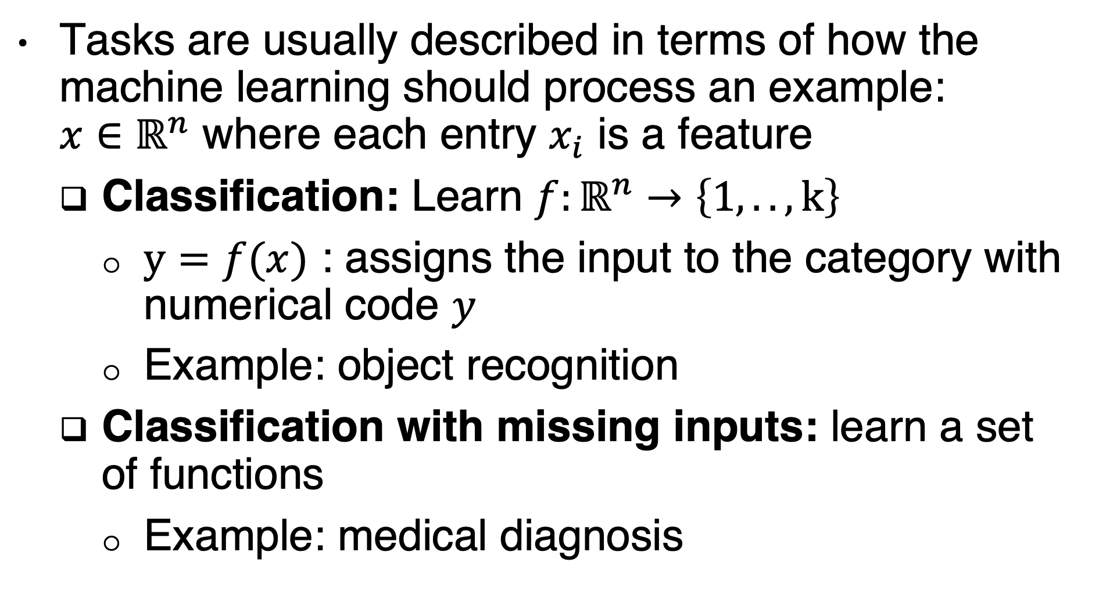
The task, T
Tasks are usually described in terms of how the machine learning should process an example: $x∈ℝ^{n}$ where each entry $x_{i}$ is a feature
Classification: Learn $f:ℝ^{n}→\left\{1,..,k\right\}$
$y=f(x)$ : assigns the input to the category with numerical code $y$
Example: object recognition
Classification with missing inputs: learn a set of functions
Example: medical diagnosis
Notes:
One way to efficiently define such a large set
of functions is to learn a probability distribution over all of the relevant
variables, then solve the classification task by marginalizing out the missing
variables. With n input variables, we can now obtain all 2^n different classification
functions needed for each possible set of missing inputs, but we only
need to learn a single function describing the joint probability distribution.

Slide 4
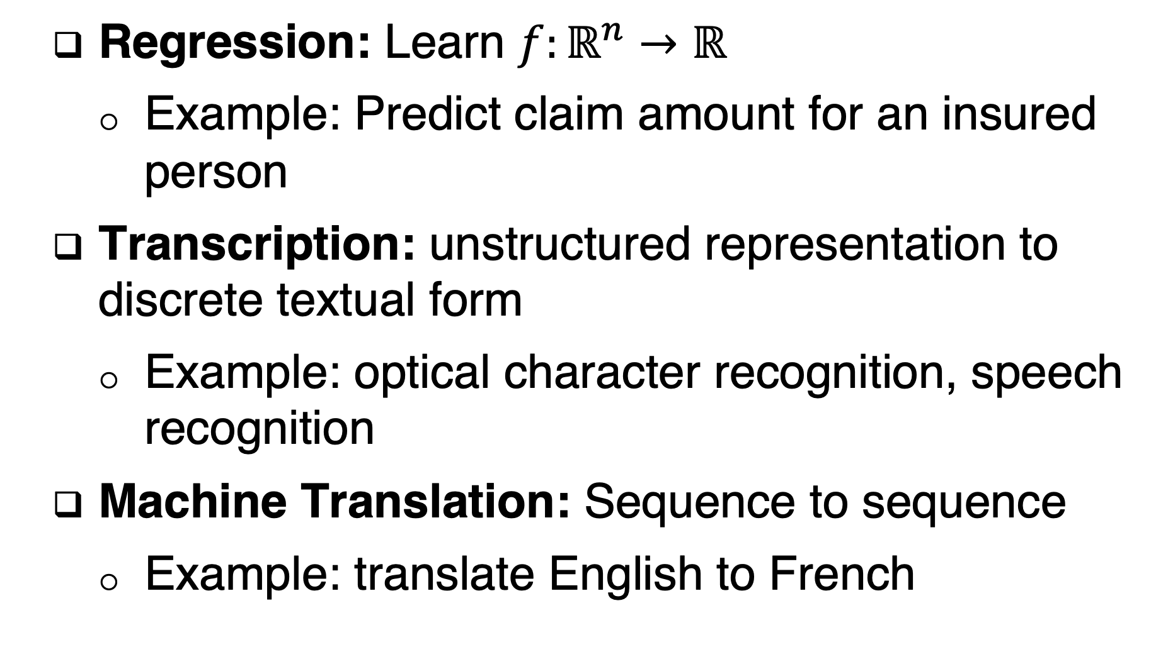
The task, T
Regression: Learn $f:ℝ^{n}→ℝ$
Example: Predict claim amount for an insured person
Transcription: unstructured representation to discrete textual form
Example: optical character recognition, speech recognition
Machine Translation: Sequence to sequence
Example: translate English to French

Slide 5
The task, T
Structured output: output is a vector or data structure of values that are tightly interrelated
Example: parsing natural language sentence into a tree that describes grammatical structure by tagging nodes of the tree as being verbs, nouns, etc.
image segmentation: assigning a pixel to a segment
Image captioning

Slide 6
The task, T
Anomaly detection: flag unusual or atypical events
Credit card fraud detection
Synthesis and sampling: generate examples that are similar to those in the training data
Genreate textures for video games
Speech synthesis
Imputation of missing values: predict the values of the missing entries

Slide 7
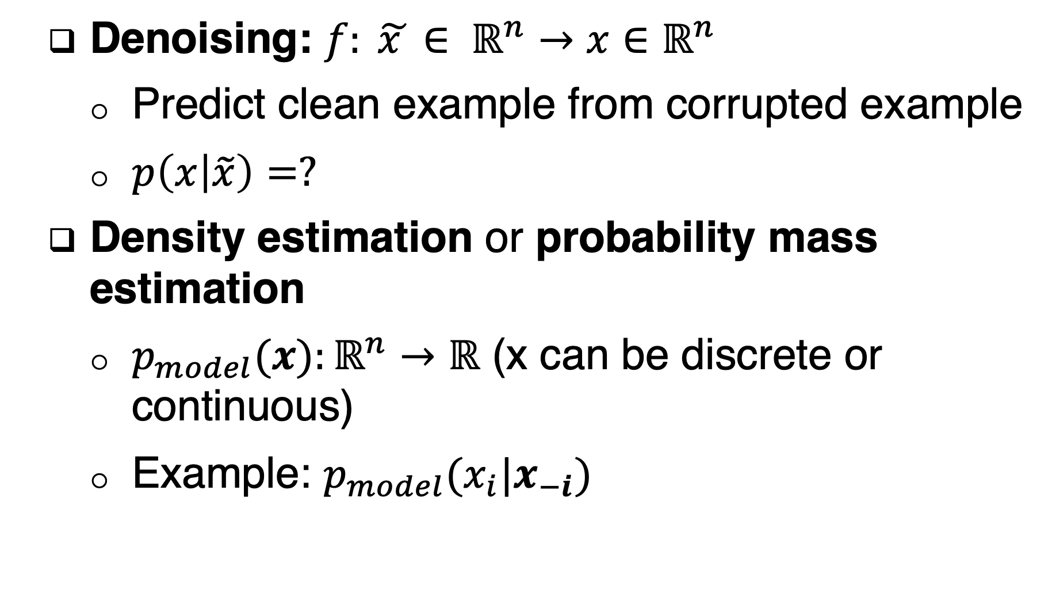
The task, T
Denoising: $f: \tilde{x }∈ ℝ^{n}→x∈ℝ^{n}$
Predict clean example from corrupted example
$p\left(x | \tilde{x}\right)=?$
Density estimation or probability mass estimation
$p_{model}(x):ℝ^{n}→ℝ$ (x can be discrete or continuous)
Example: $p_{model}(x_{i}|x_{−i})$

Slide 8
The performance measure, P
Accuracy:
The proportion of examples for which the model produces the correct output
Error rate (0-1 loss):
The proportion of examples for which the model produces incorrect output
Average log-probability of some examples (for density estimation)
It is difficult sometimes, to decide what should be measured
It is imparactical sometimes to measure an implicit performance metric
Evaluate the performance measure using a test set

Slide 9
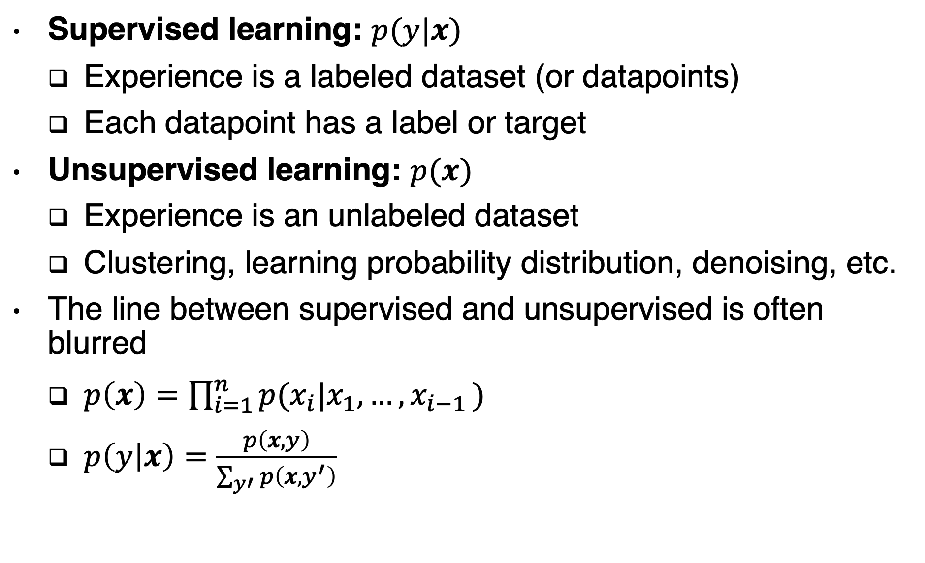
The experience, E
Supervised learning: $p(y|x)$
Experience is a labeled dataset (or datapoints)
Each datapoint has a label or target
Unsupervised learning: $p(x)$
Experience is an unlabeled dataset
Clustering, learning probability distribution, denoising, etc.
The line between supervised and unsupervised is often blurred
$p\left(x\right)=\prod_{i=1}^{n}{p(x_{i}|x_{1},…, x_{i−1 })}$
$p\left(y | x\right)=\frac{p\left(x,y\right)}{\sum_{y′}{p\left(x,y^{′}\right)}}$

Slide 10
The experience, E
Semi-Supervised learning:
Some examples include supervision targets, but others do not.
Multi-instance learning:
A collection of examples is labeled as containing an example of a class
Reinforcement learning:
Interaction with an environment

Slide 11
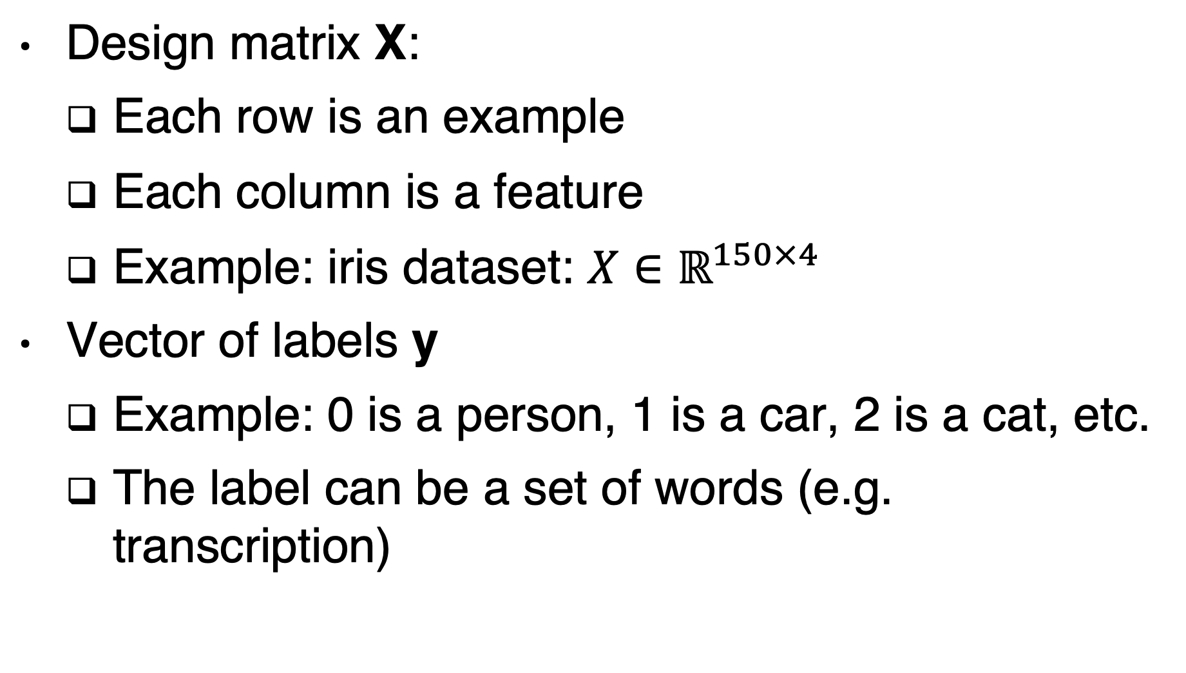
A dataset
Design matrix X:
Each row is an example
Each column is a feature
Example: iris dataset: $X∈ℝ^{150×4}$
Vector of labels y
Example: 0 is a person, 1 is a car, 2 is a cat, etc.
The label can be a set of words (e.g. transcription)

Slide 12
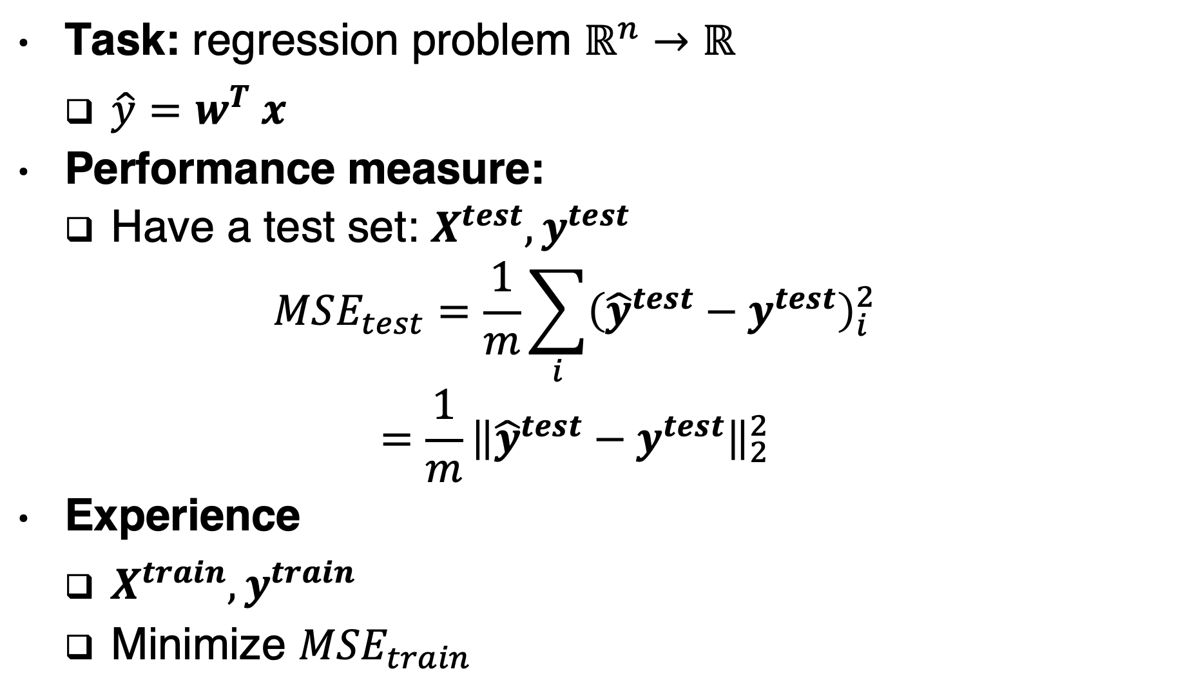
Example: Linear regression
Task: regression problem $ℝ^{n}→ℝ$
$\hat{y}=w^{T} x$
Performance measure:
Have a test set: $X^{test}, y^{test}$
$$MSE_{test}=\frac{1}{m}\sum_{i}{{\left({\hat{y}}^{test}−y^{test}\right)}_{i}^{2}}$$
$$=\frac{1}{m}{\left\|{\hat{y}}^{test}−y^{test}\right\|}_{2}^{2}$$
Experience
$X^{train}, y^{train}$
Minimize $MSE_{train}$

Slide 13
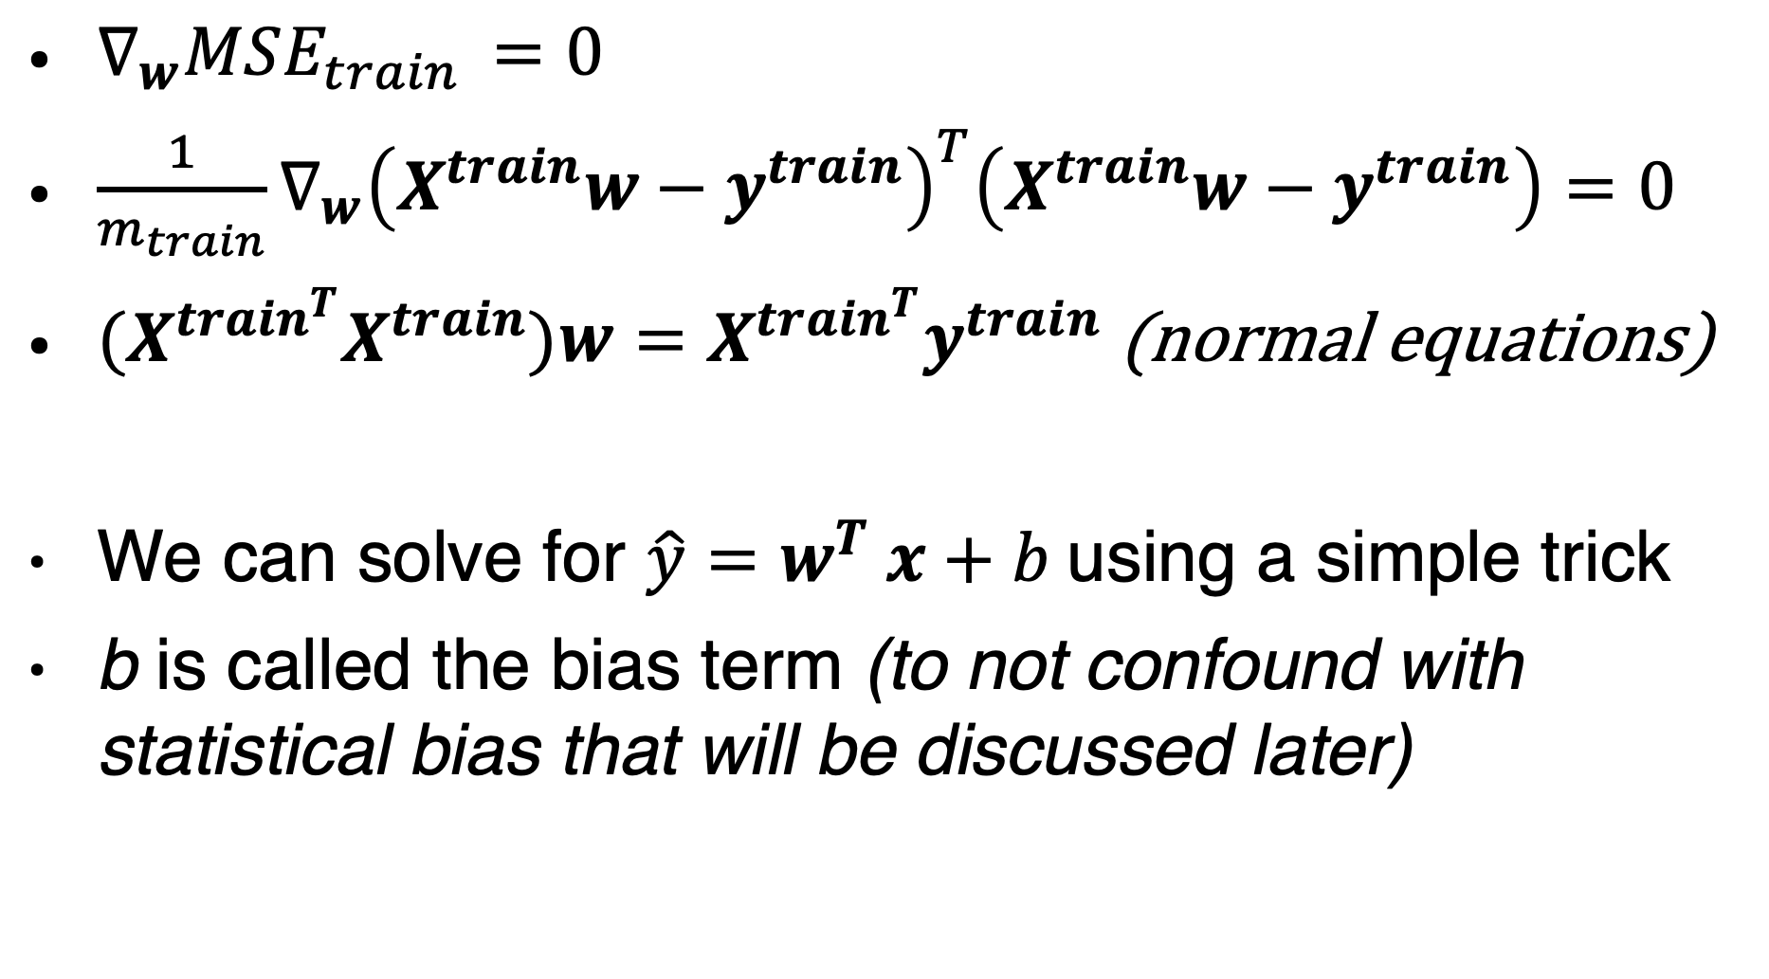
Linear regression
$∇_{w}MSE_{train }=0$
$\frac{1}{m_{train}}∇_{w}{\left(X^{train}w−y^{train}\right)}^{T}\left(X^{train}w−y^{train}\right)=0$
$(X^{train^{T}}X^{train})w=X^{train^{T}}y^{train}$ (normal equations)
We can solve for $\hat{y}=w^{T} x+b$using a simple trick
b is called the bias term (to not confound with statistical bias that will be discussed later)

Slide 14
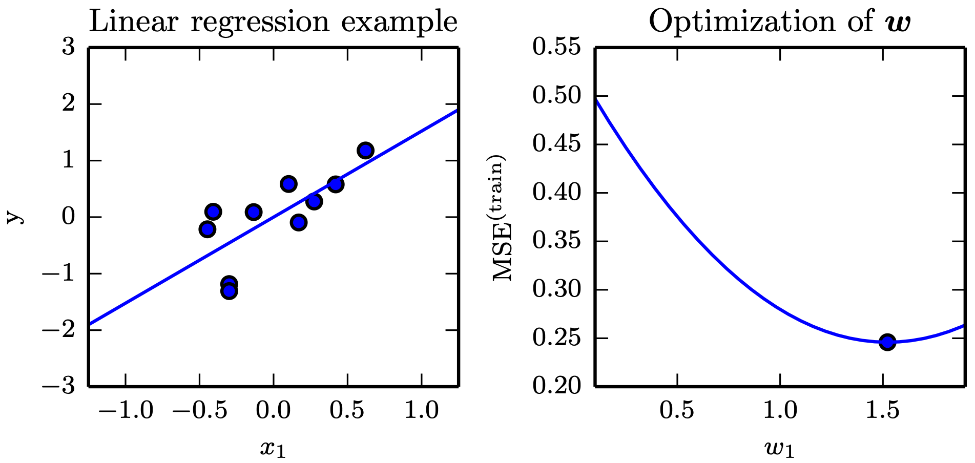
Linear Regression
Figure 5.1

Slide 15
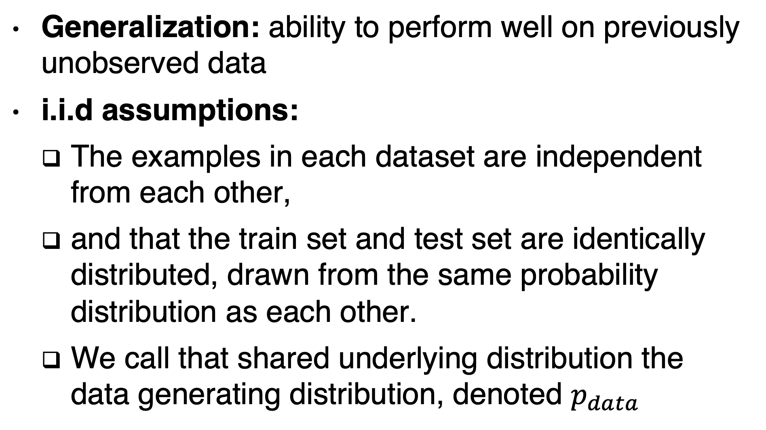
Capacity, overfitting and underfitting
Generalization: ability to perform well on previously unobserved data
i.i.d assumptions:
The examples in each dataset are independent from each other,
and that the train set and test set are identically distributed, drawn from the same probability distribution as each other.
We call that shared underlying distribution the data generating distribution, denoted $p_{data}$

Slide 16
Capacity, overfitting and underfitting
For some fixed value w, the expected training set error is exactly the same as the expected test set error, because both expectations are formed using the same dataset sampling process.
In practice:
expected test set error > expected train set error
We need ability to:
1. Make the training error small. (underfitting)
2. Make the gap between training and test error small. (overfitting)

Slide 17
Capacity, overfitting and underfitting
Underfitting occurs when the model is not able to obtain a sufficiently low error value on the training set.
Overfitting occurs when the gap between the training error and test error is too large.
Informally, a model’s capacity is its ability to fit a wide variety of functions.
Low capacity may cause underfitting
High capacity may cause overfitting

Slide 18
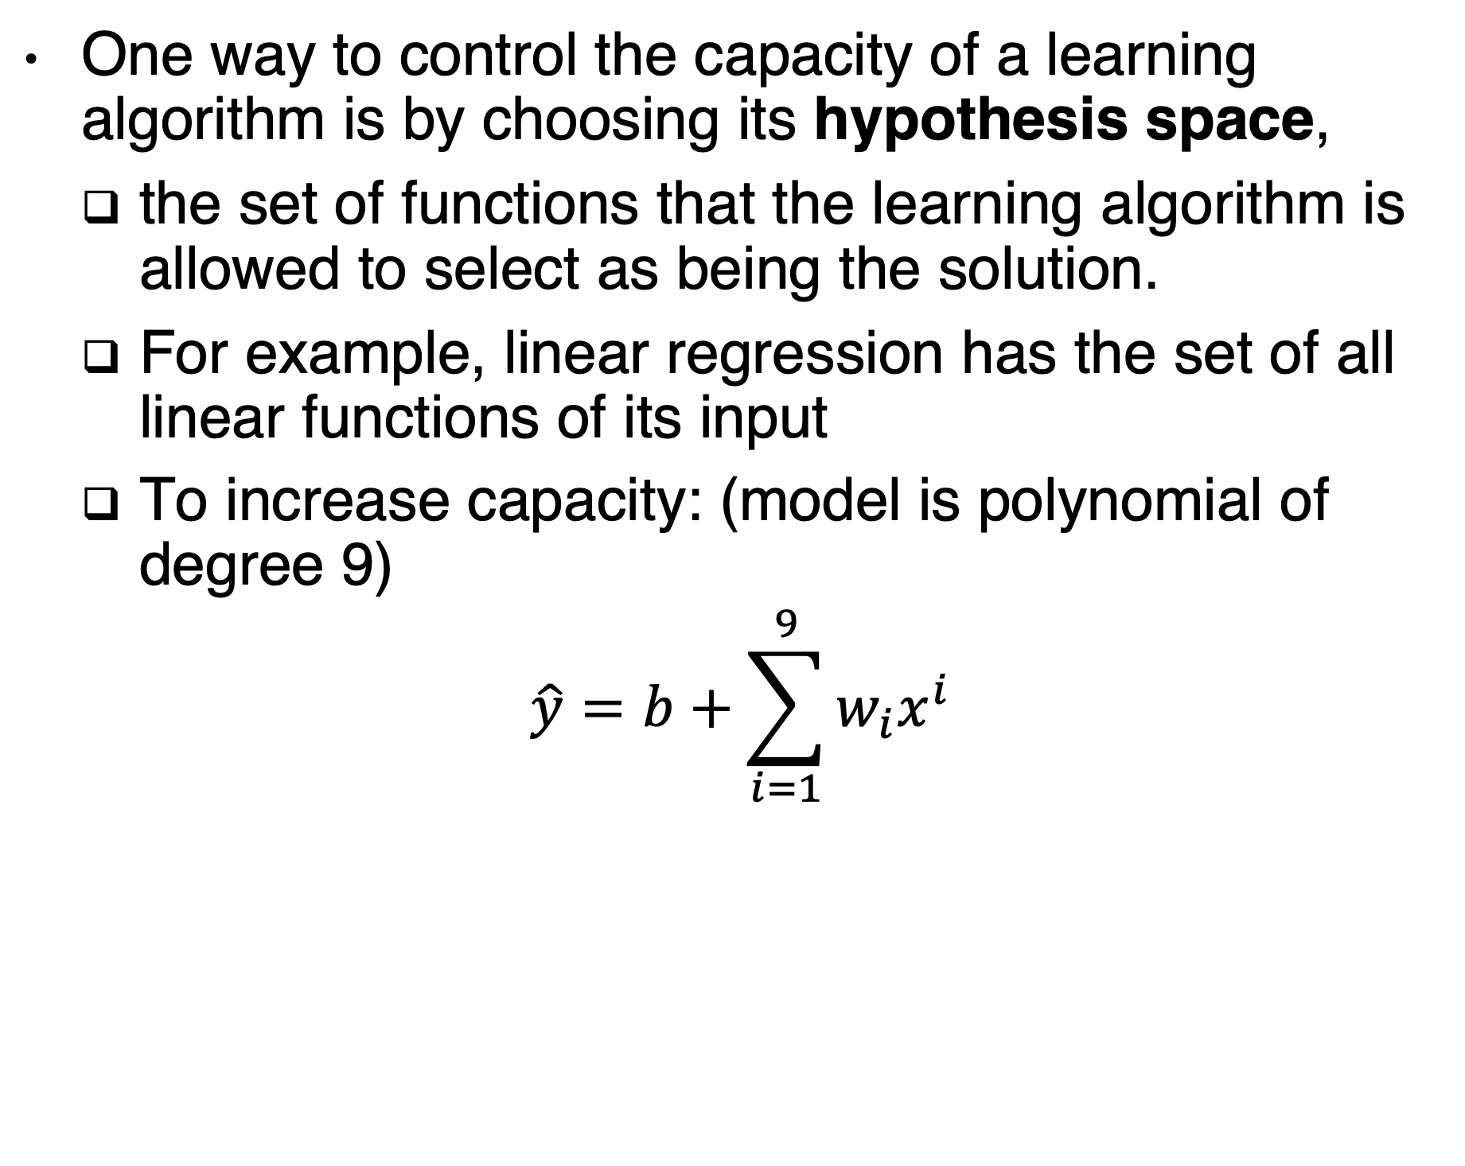
Hypothesis space
One way to control the capacity of a learning algorithm is by choosing its hypothesis space,
the set of functions that the learning algorithm is allowed to select as being the solution.
For example, linear regression has the set of all linear functions of its input
To increase capacity: (model is polynomial of degree 9)
$$\hat{y}=b+\sum_{i=1}^{9}{w_{i}x^{i}}$$

Slide 19
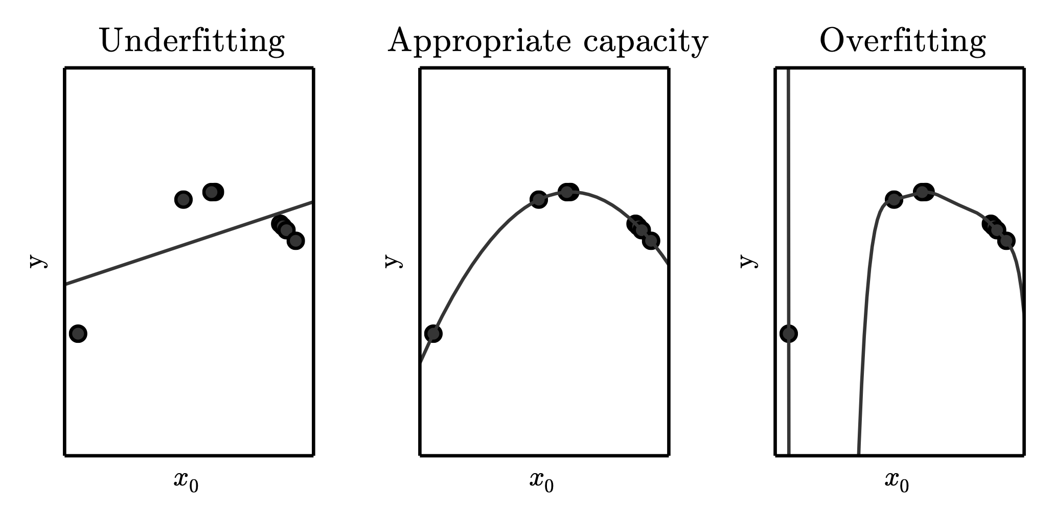
Underfitting and Overfitting in Polynomial Estimation
Degree 1
Degree 2
Degree 9: infinitely many solutions

Slide 20
Capacity
Representational capacity: finding the best function within a family of functions
Effective capacity may be less than the representational capacity because it is hard to find the best function
Occam’s razor: Among competing hypotheses that explain known observations equally well, one should choose the “simplest” one.
Statistical learning theory shows that the discrepancy between training error and generalization error is bounded from above by a quantity that grows as the model capacity grows but shrinks as the number of training examples increases
Notes:
Vapnik-Chervonenkis dimension, or VC dimension: It measures the capacity of a binary classifier.
The VC dimension is defined as being the largest possible value of m for which there exists a training set of m different x points that the classifier can label arbitrarily

Slide 21
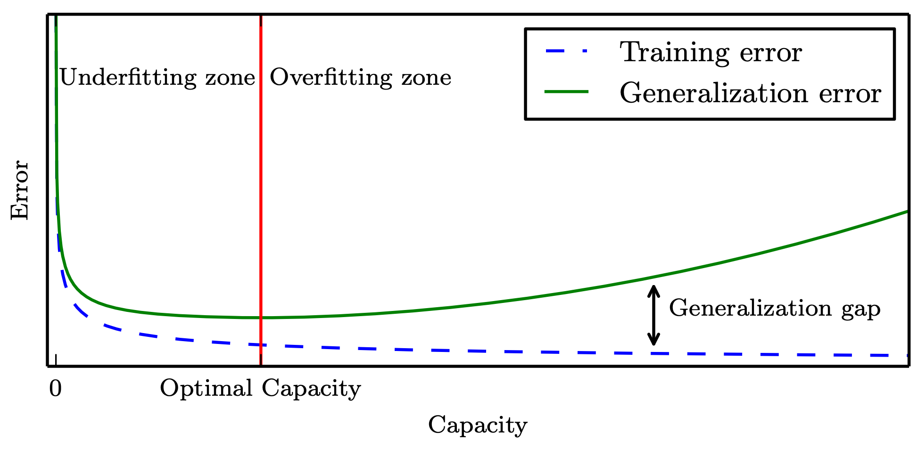
Generalization and Capacity
Figure 5.3

Slide 22
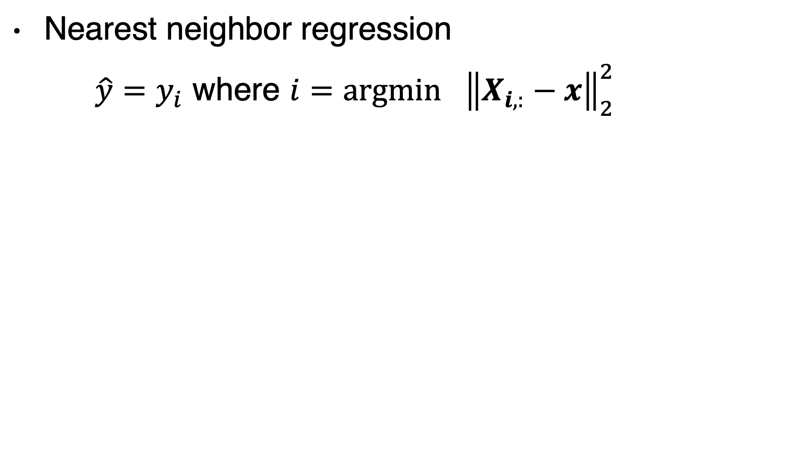
High capacity: non-parametric models
Nearest neighbor regression
$\hat{y}=y_{i}$ where $i=\underset{}{argmin}{{\left\|X_{i,:}−x\right\|}_{2}^{2}}$

Slide 23
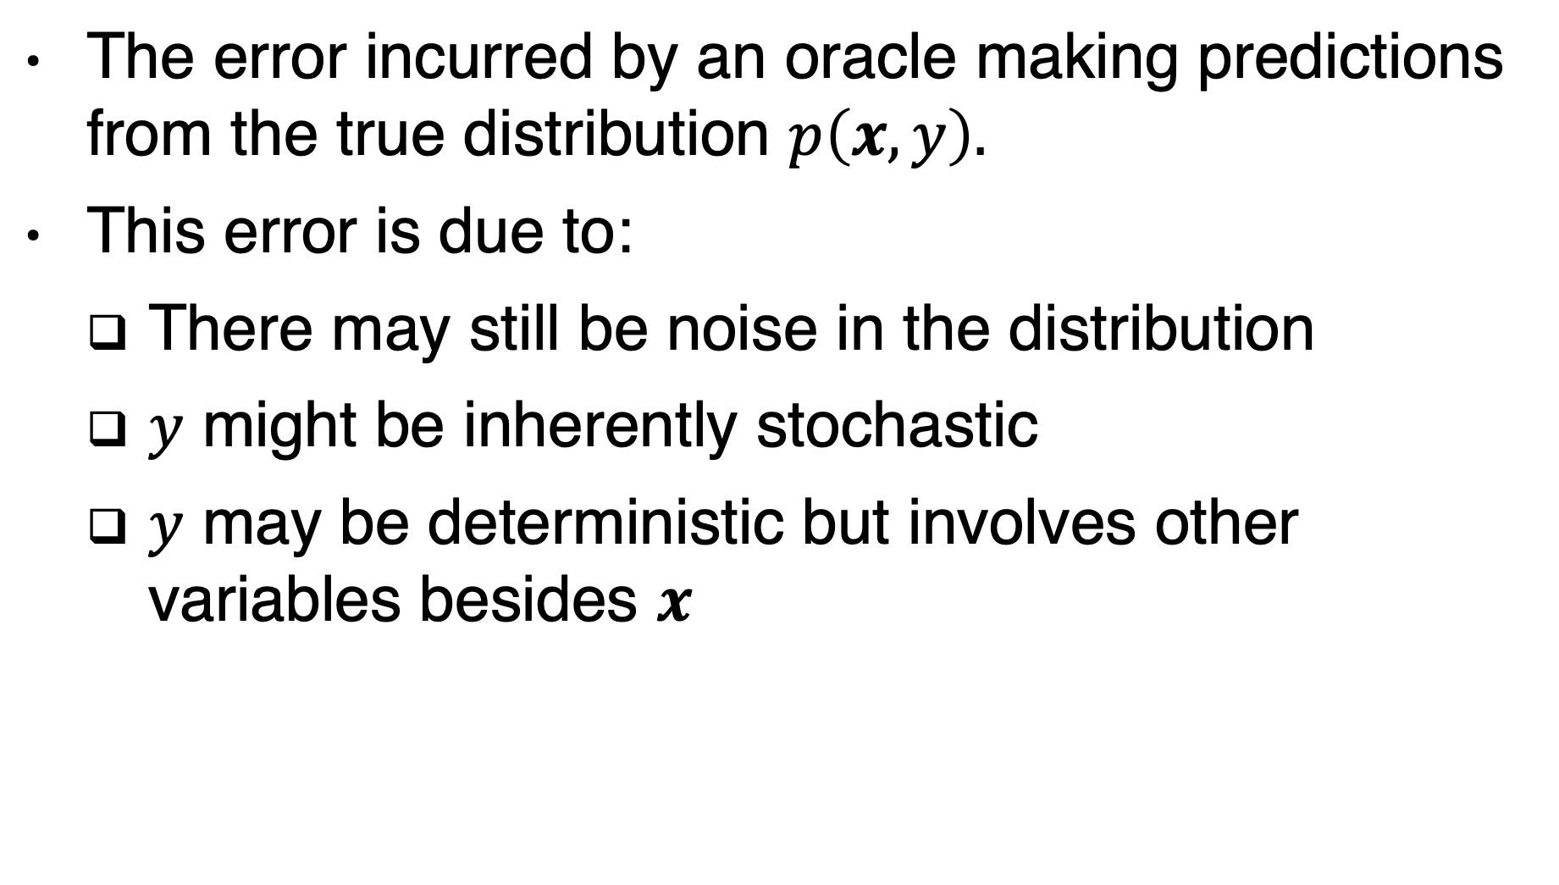
Bayes error
The error incurred by an oracle making predictions from the true distribution $p\left(x, y\right).$
This error is due to:
There may still be noise in the distribution
$y$ might be inherently stochastic
$y$ may be deterministic but involves other variables besides $x$

Slide 24
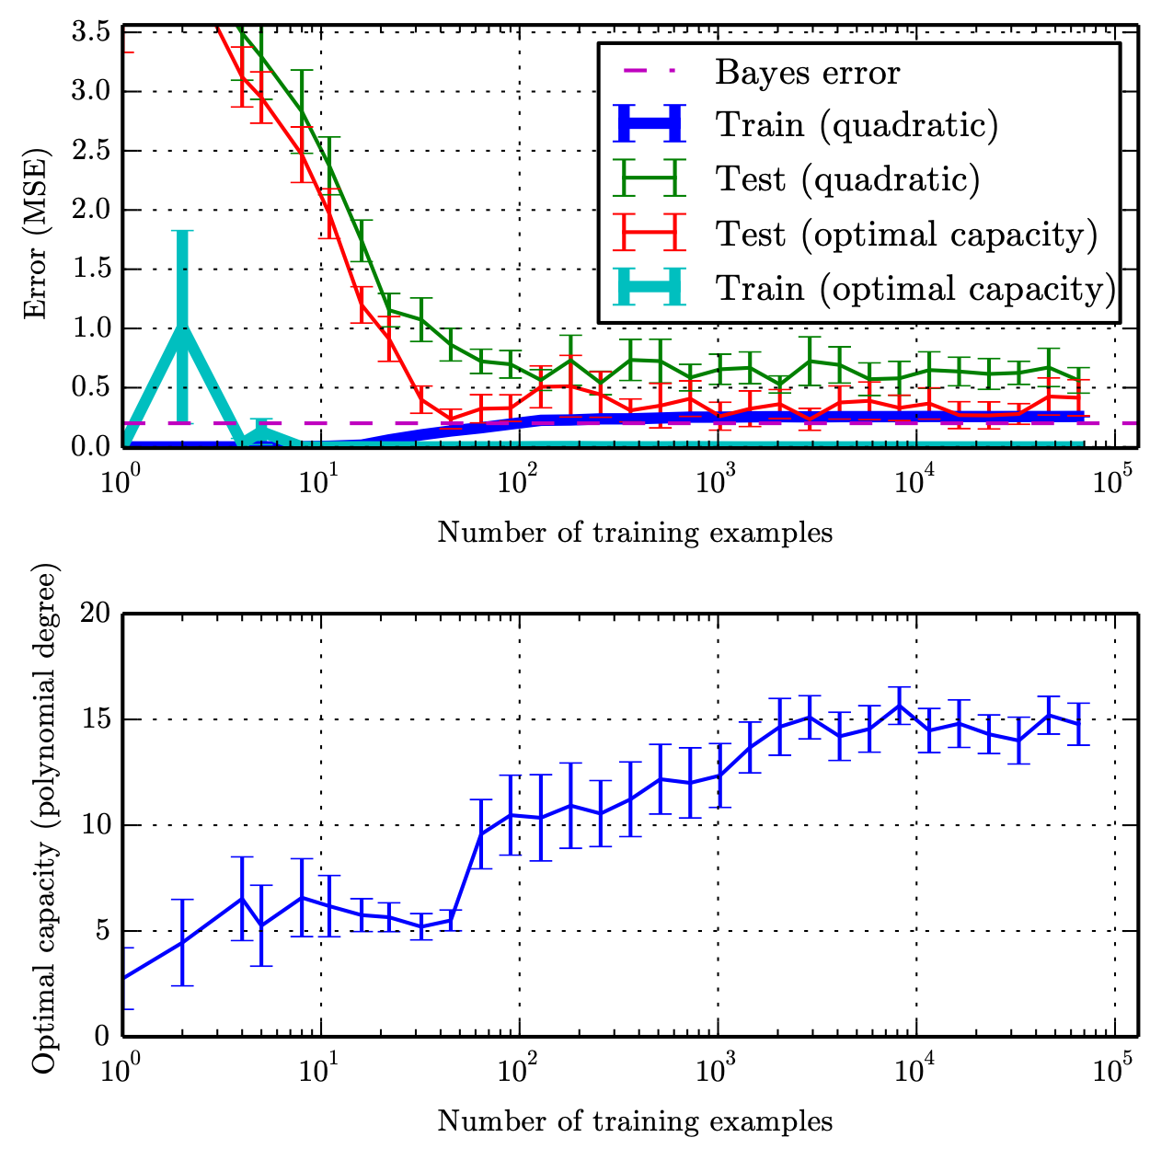
Training Set Size
moderate amount of noise added to a degree-5 polynomial

Slide 25
The no Free lunch theorem
Averaged over all possible data generating distributions, every classification algorithm has the same error rate when classifying previously unobserved points.
In some sense, no machine learning algorithm is universally any better than any other.
The most sophisticated algorithm we can conceive of has the same average performance (over all possible tasks) as merely predicting that every point belongs to the same class.

Slide 26
No free lunch
The goal of machine learning research is not to seek a universal learning algorithm or the absolute best learning algorithm.
Instead, our goal is to understand what kinds of distributions are relevant to the “real world”
and what kinds of machine learning algorithms perform well on data drawn distributions we care about.

Slide 27
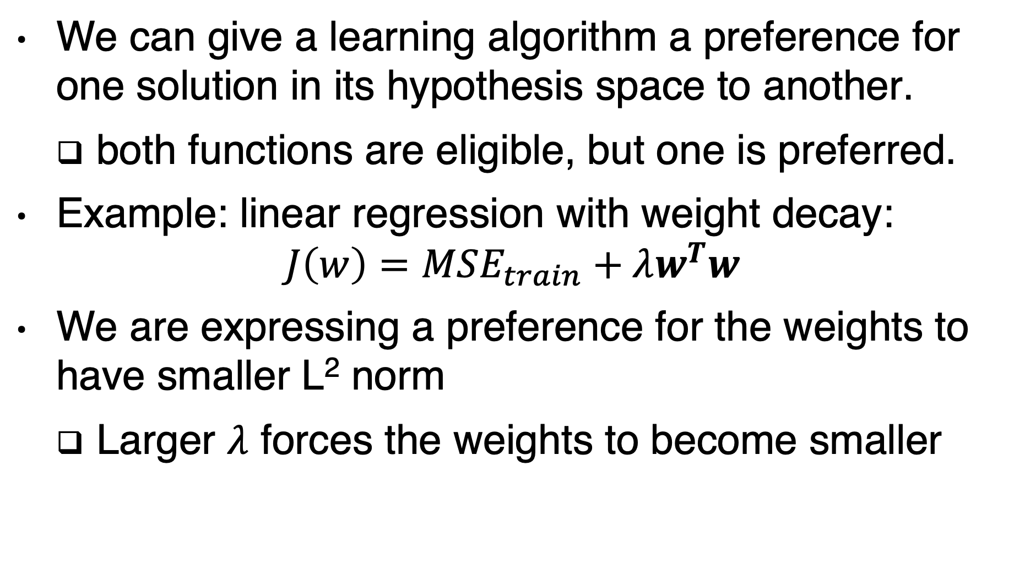
Regularization
We can give a learning algorithm a preference for one solution in its hypothesis space to another.
both functions are eligible, but one is preferred.
Example: linear regression with weight decay:
$$J\left(w\right)=MSE_{train}+λw^{T}w$$
We are expressing a preference for the weights to have smaller L² norm
Larger $λ$ forces the weights to become smaller

Slide 28
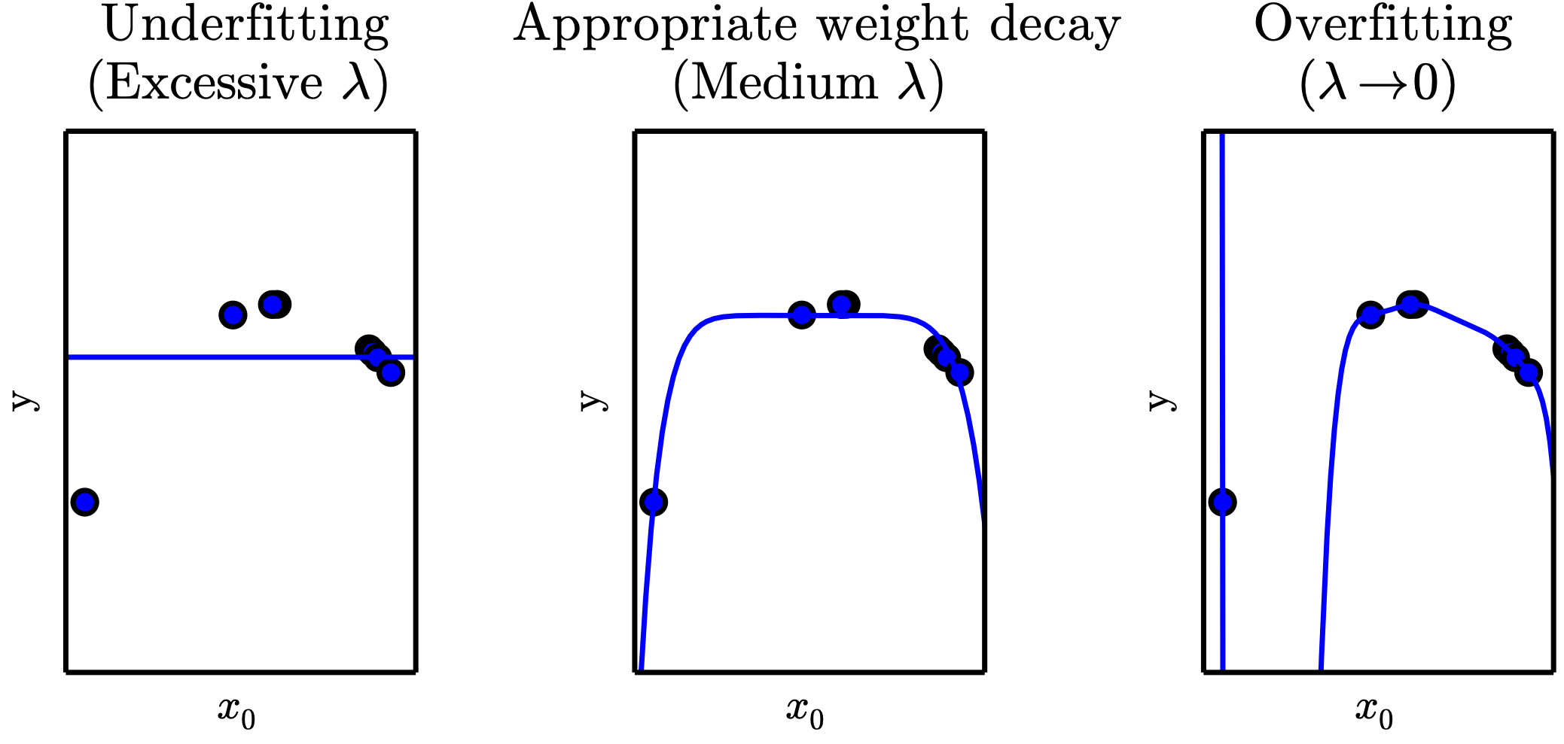
Weight Decay
The true function is quadratic,
but here we use only models with degree 9

Slide 29
Regularization
Regularization is any modification we make to a learning algorithm that is intended to reduce its generalization error but not its training error.
Regularization is one of the central concerns of the field of machine learning

Slide 30
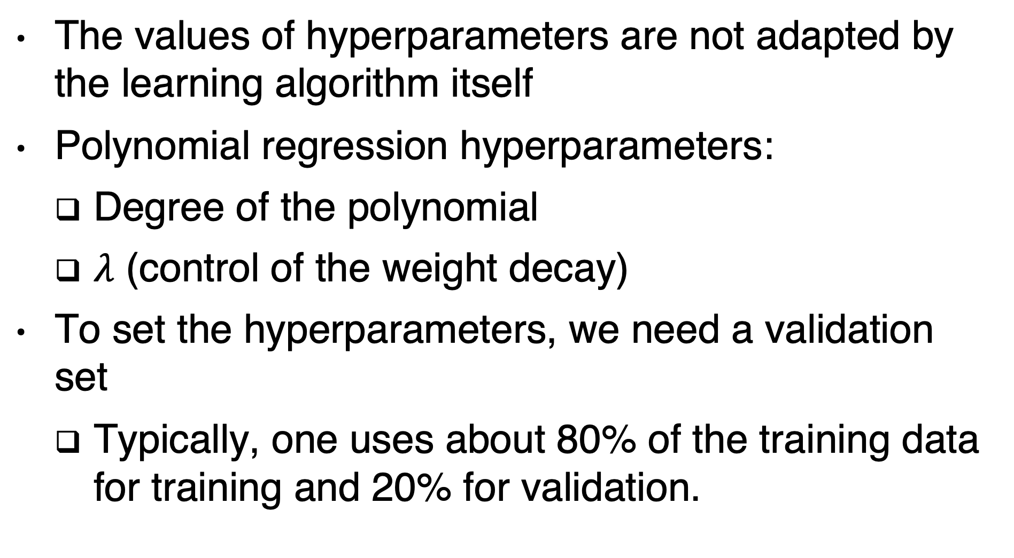
Hyperparameters
The values of hyperparameters are not adapted by the learning algorithm itself
Polynomial regression hyperparameters:
Degree of the polynomial
$λ$ (control of the weight decay)
To set the hyperparameters, we need a validation set
Typically, one uses about 80% of the training data for training and 20% for validation.

Slide 31
Cross validation
It is used to estimate generalization error of a learning algorithm A when the given dataset D is too small for a simple train/test or train/valid split to yield accurate estimation of generalization error
In k-fold cross-validation a partition of the dataset is formed by splitting it into k non-overlapping subsets.
The test error may then be estimated by taking the average test error across k trials. On trial i, the i-th subset of the data is used as the test set and the rest of the data is used as the training set.

Slide 32
Cross validation

Slide 33
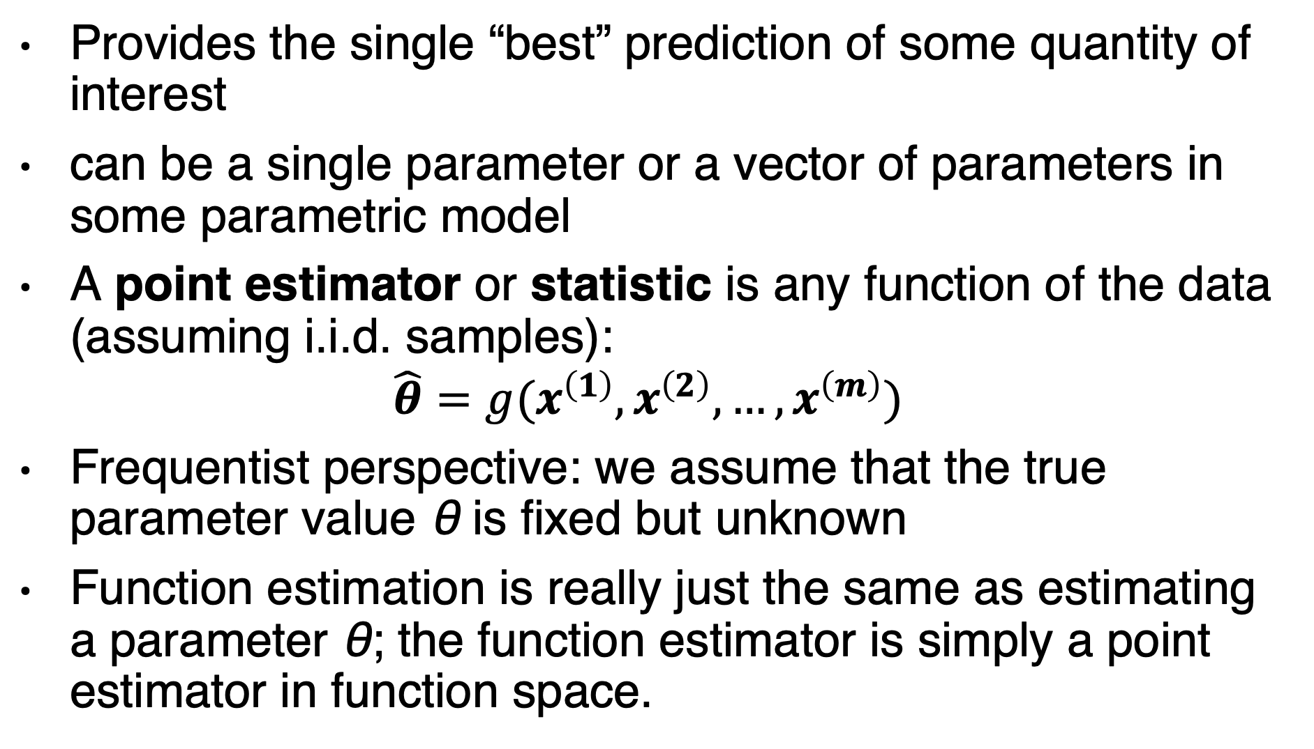
Point estimation
Provides the single “best” prediction of some quantity of interest
can be a single parameter or a vector of parameters in some parametric model
A point estimator or statistic is any function of the data (assuming i.i.d. samples):
$$\hat{θ}=g(x^{\left(1\right)},x^{\left(2\right)},…, x^{\left(m\right)})$$
Frequentist perspective: we assume that the true parameter value θ is fixed but unknown
Function estimation is really just the same as estimating a parameter θ; the function estimator is simply a point estimator in function space.

Slide 34
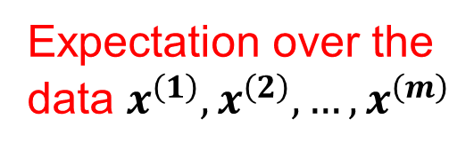
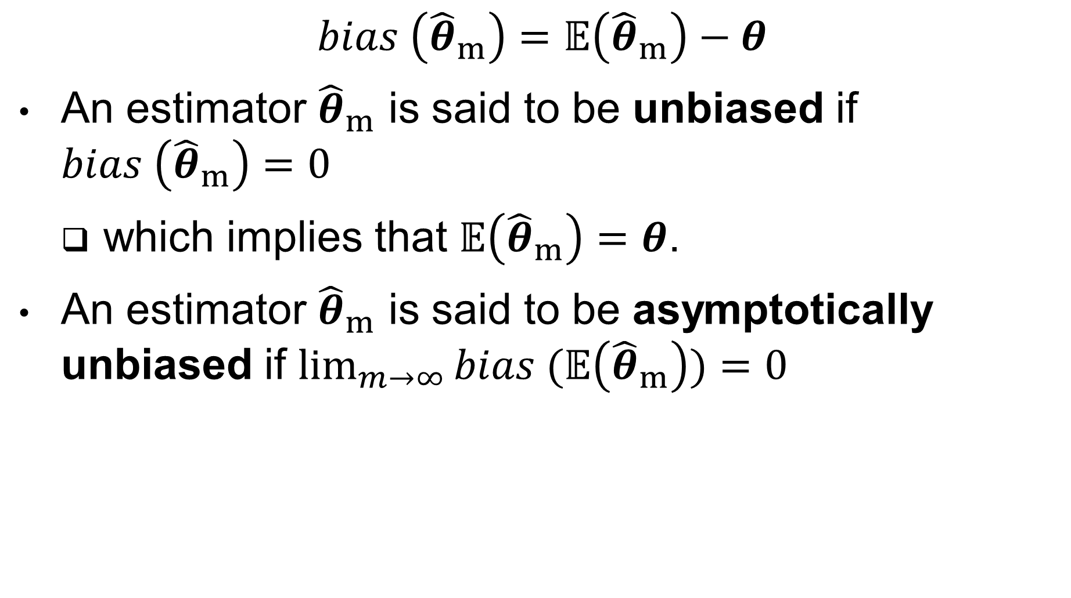
Statistical bias
Expectation over the data $x^{\left(1\right)},x^{\left(2\right)},…, x^{\left(m\right)}$
$$bias \left({\hat{θ}}_{m}\right)=𝔼\left({\hat{θ}}_{m}\right)−θ$$
An estimator ${\hat{θ}}_{m}$ is said to be unbiased if $bias \left({\hat{θ}}_{m}\right)=0$
which implies that $𝔼\left({\hat{θ}}_{m}\right)=θ$.
An estimator ${\hat{θ}}_{m}$ is said to be asymptotically unbiased if $\lim_{m→∞}{bias (𝔼\left({\hat{θ}}_{m}\right))=0 }$

Slide 35
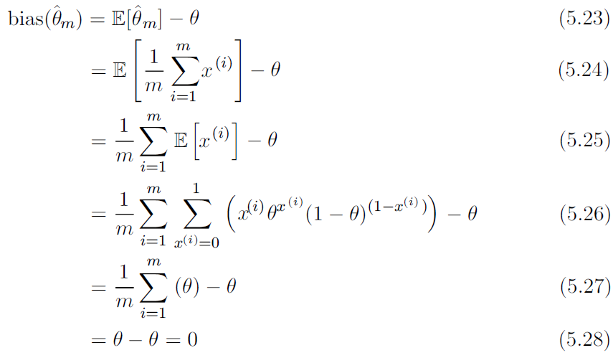
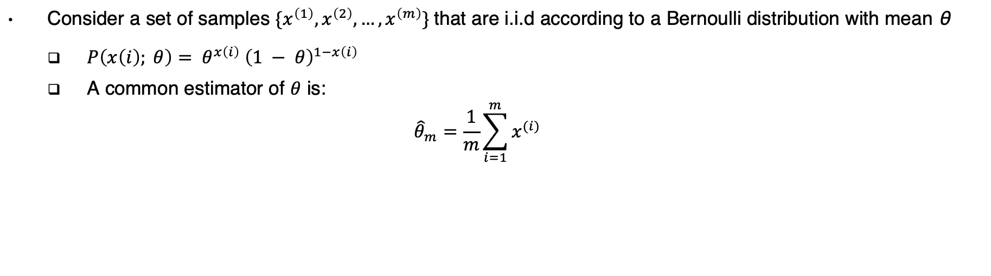
Example: Bernoulli distribution
Consider a set of samples ${\{x}^{\left(1\right)},x^{\left(2\right)},…, x^{\left(m\right)}\}$that are i.i.d according to a Bernoulli distribution with mean θ
$P\left(x\left(i\right); θ\right)= θ^{x\left(i\right)} {\left(1 − θ\right)}^{1−x\left(i\right)}$
A common estimator of $θ$ is:
$${\hat{θ}}_{m}=\frac{1}{m}\sum_{i=1}^{m}{x^{(i)}}$$

Slide 36
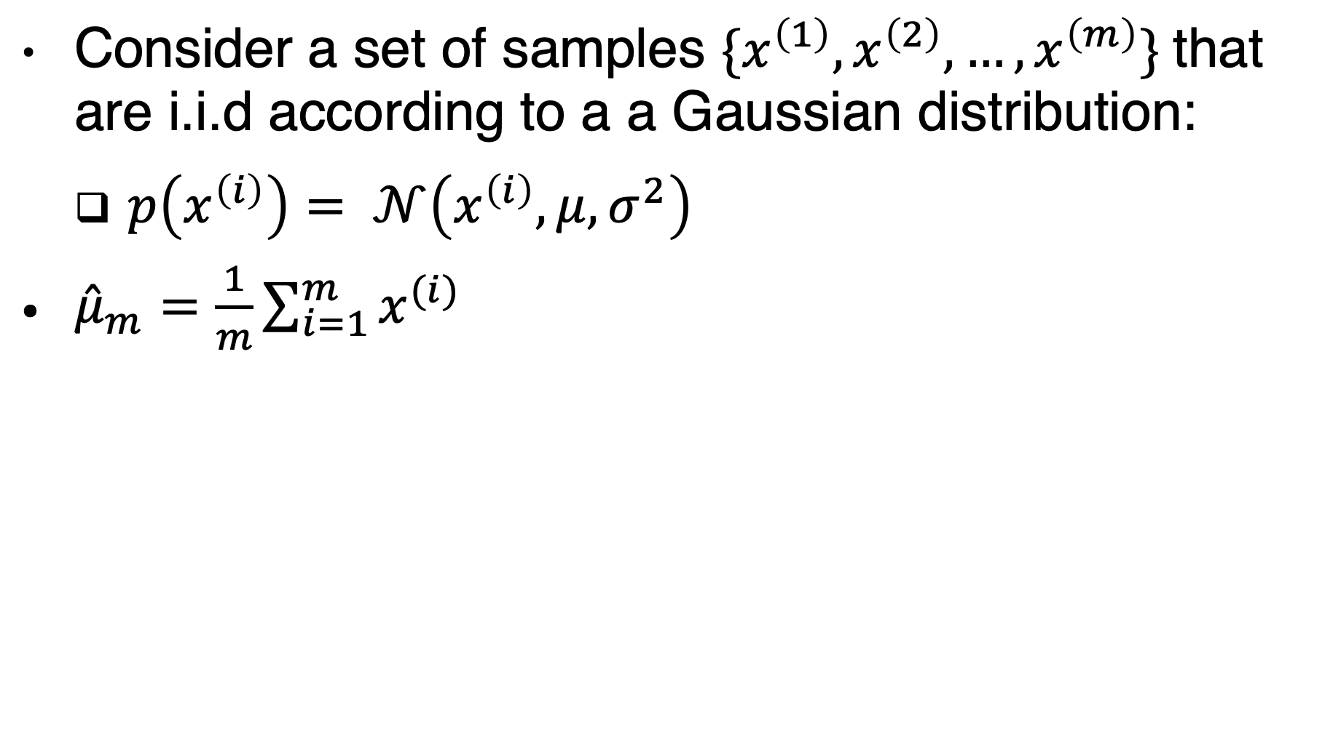
Example: Gaussian distribution - mean
Consider a set of samples ${\{x}^{\left(1\right)},x^{\left(2\right)},…, x^{\left(m\right)}\}$that are i.i.d according to a a Gaussian distribution:
$p\left(x^{\left(i\right)}\right)= 𝒩\left(x^{\left(i\right)}, μ, σ^{2}\right)$
${\hat{μ}}_{m}=\frac{1}{m}\sum_{i=1}^{m}{x^{(i)}}$
The sample mean is an unbiased estimator of Gaussian mean parameter.

Slide 37
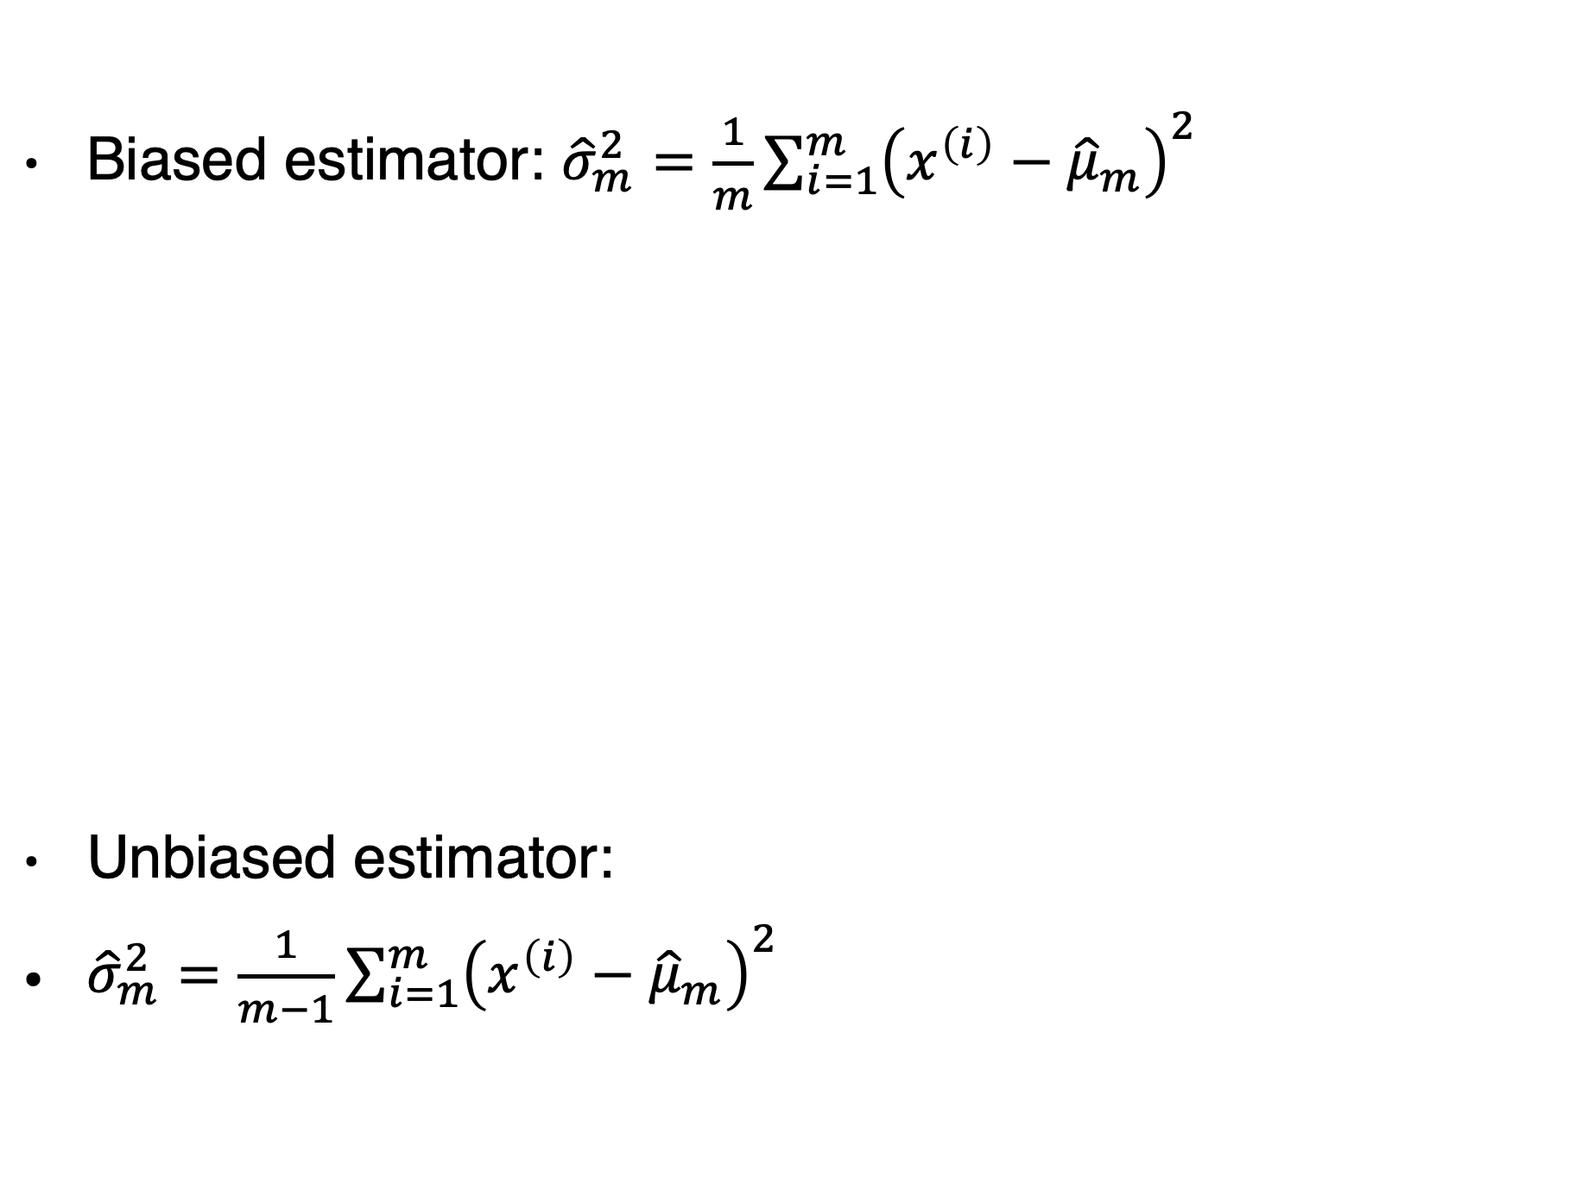
Example: Gaussian distribution - variance
Biased estimator: ${\hat{σ}}_{m}^{2}=\frac{1}{m}\sum_{i=1}^{m}{{\left(x^{\left(i\right)}−{\hat{μ}}_{m}\right)}^{2}}$
Unbiased estimator:
${\hat{σ}}_{m}^{2}=\frac{1}{m−1}\sum_{i=1}^{m}{{\left(x^{\left(i\right)}−{\hat{μ}}_{m}\right)}^{2}}$
The sample variance is a biased estimator.

Slide 38
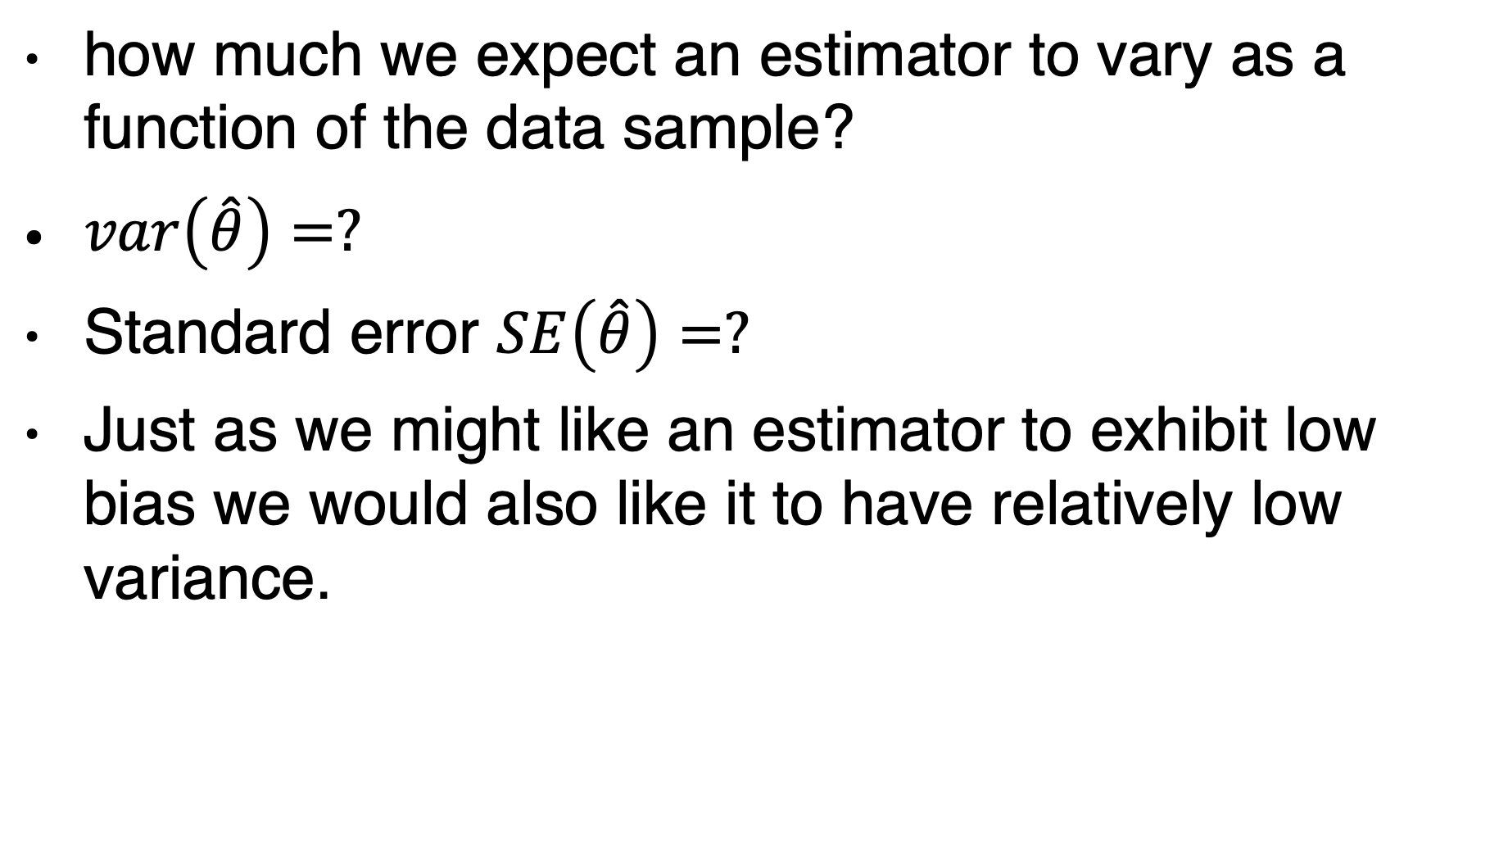
Variance
how much we expect an estimator to vary as a function of the data sample?
$var\left(\hat{θ}\right)=?$
Standard error $SE\left(\hat{θ}\right)=?$
Just as we might like an estimator to exhibit low bias we would also like it to have relatively low variance.

Slide 39
Example: Bernoulli distribution
The variance of the estimator decreases as a function of m, the number of examples in the dataset.

Slide 40
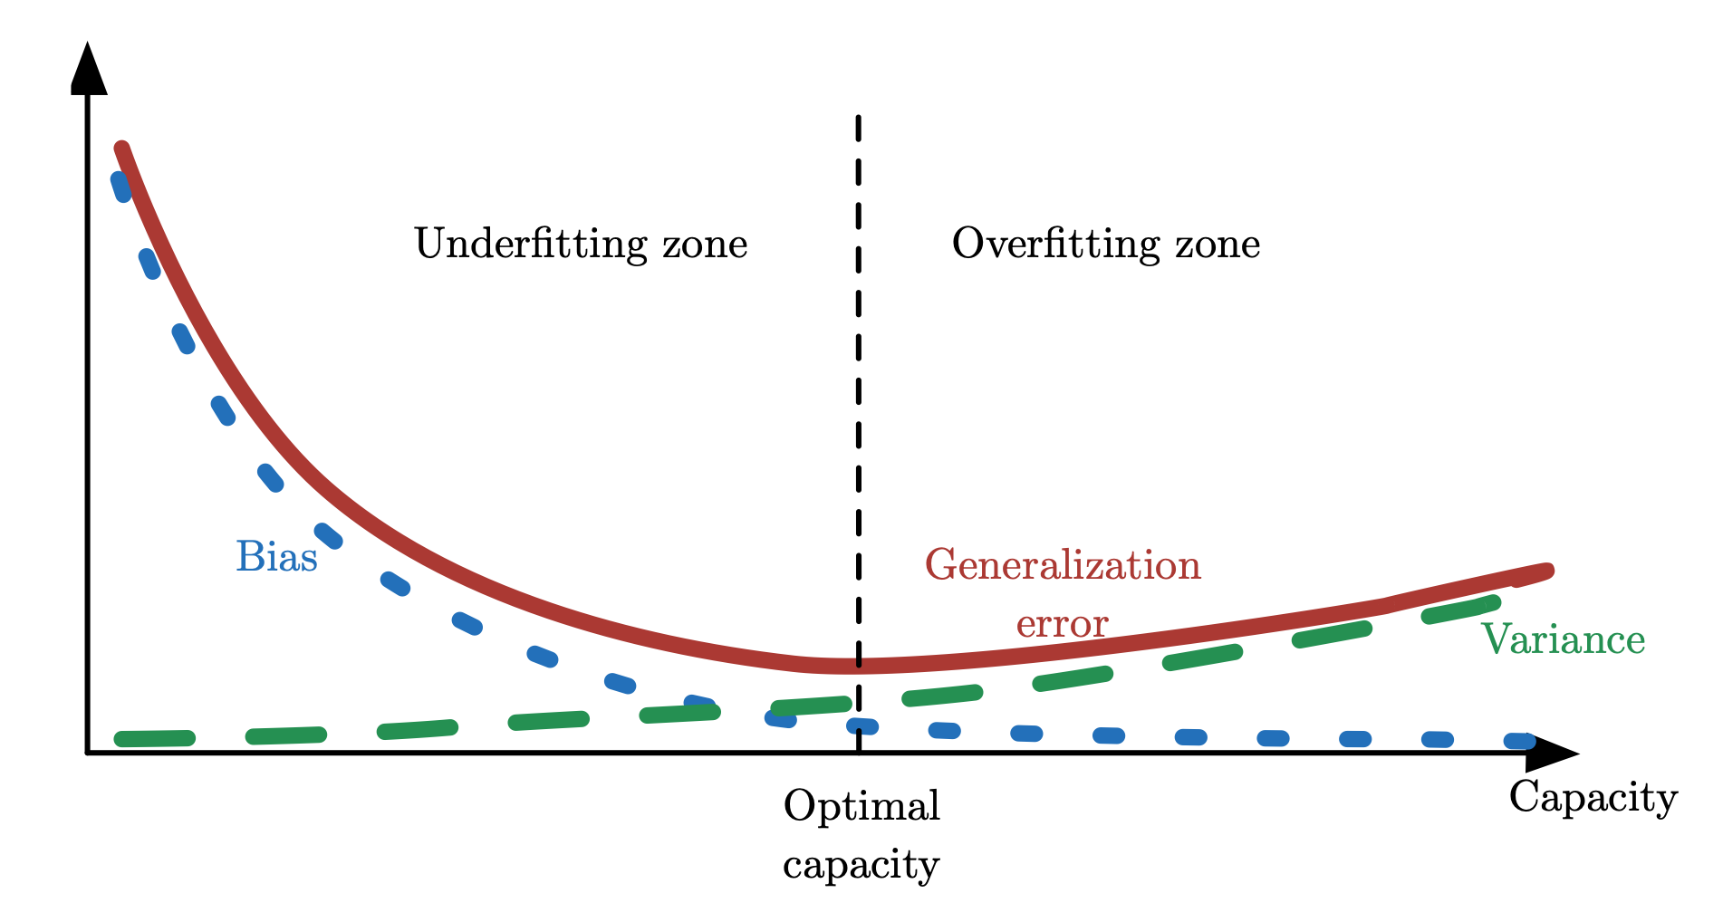
Trading off Bias and Variance
Figure 5.6

Slide 41
Bias vs. variance

Slide 42
Bias vs. variance

Slide 43
Maximum Likelihood Estimation
Rather than guessing that some function might make a good estimator and then analyzing its bias and variance, we would like to have some principle from which we can derive specific functions that are good estimators for different models.
Same as:

Slide 44
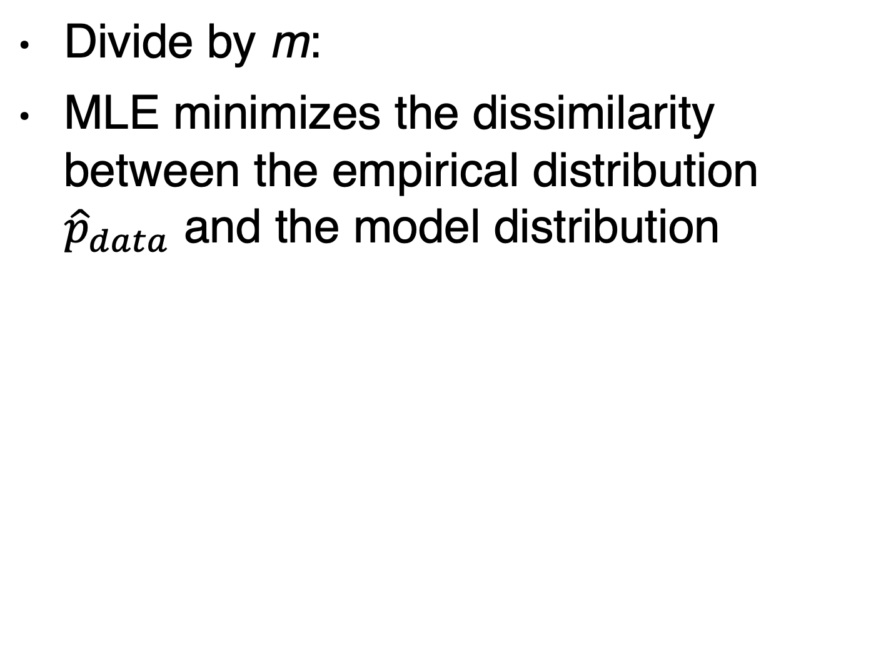
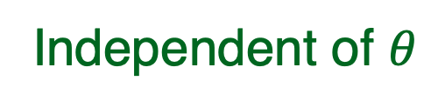
Maximum Likelihood Estimation
Divide by m:
MLE minimizes the dissimilarity between the empirical distribution ${\hat{p}}_{data}$ and the model distribution
Empirical distribution
Any loss consisting of a negative log-likelihood is a cross-entropy between the empirical distribution defined by the training set and the probability distribution defined by model.
Independent of $θ$
Notes:
Maximum likelihood thus becomes minimization of the negative log-likelihood
(NLL), or equivalently, minimization of the cross entropy.
The negative
log-likelihood can actually become negative when x is real-valued.

Slide 45
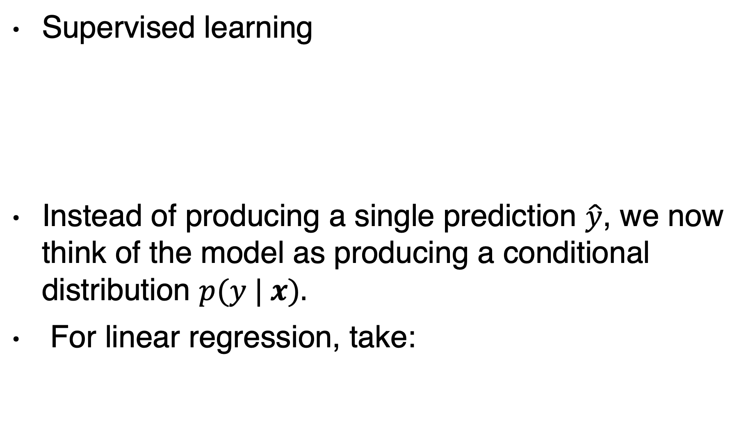
Conditional log-likelihood
Supervised learning
Instead of producing a single prediction $\hat{y}$, we now think of the model as producing a conditional distribution $p(y | x).$
For linear regression, take:
Output of linear regression as the mean
fixed

Slide 46
Conditional log-likelihood for linear regression
To maximize:
Same as minimizing:
From the dataset
Output of linear regression as the mean

Slide 47
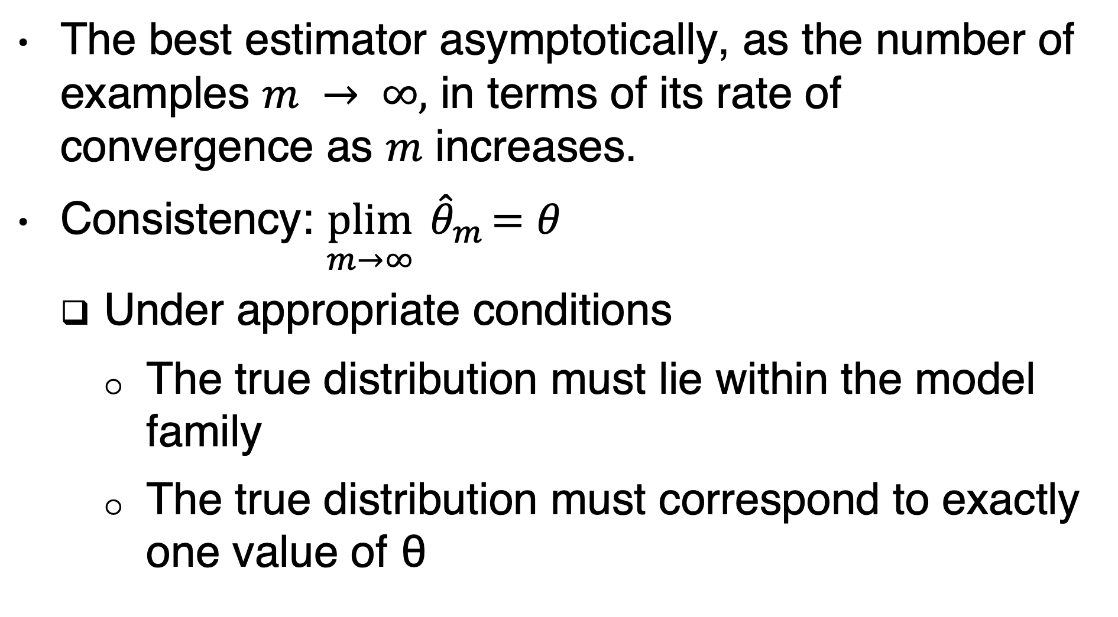
Properties of maximum likelihood
The best estimator asymptotically, as the number of examples $m → ∞,$ in terms of its rate of convergence as $m$ increases.
Consistency: $\underset{m→∞}{plim}{ \hat{θ}}_{m}=θ$
Under appropriate conditions
The true distribution must lie within the model family
The true distribution must correspond to exactly one value of θ

Slide 48
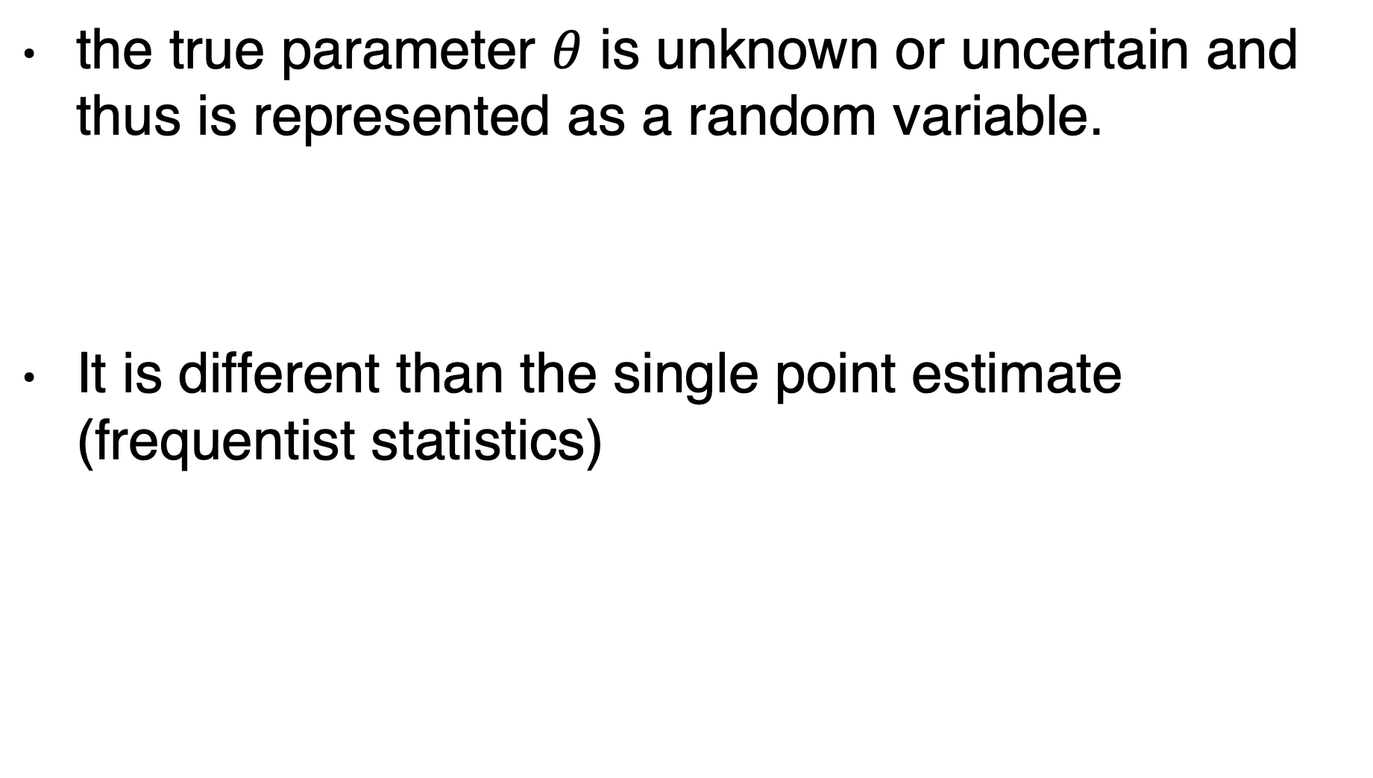
Bayesian statistics
the true parameter $θ$ is unknown or uncertain and thus is represented as a random variable.
It is different than the single point estimate (frequentist statistics)

Slide 49
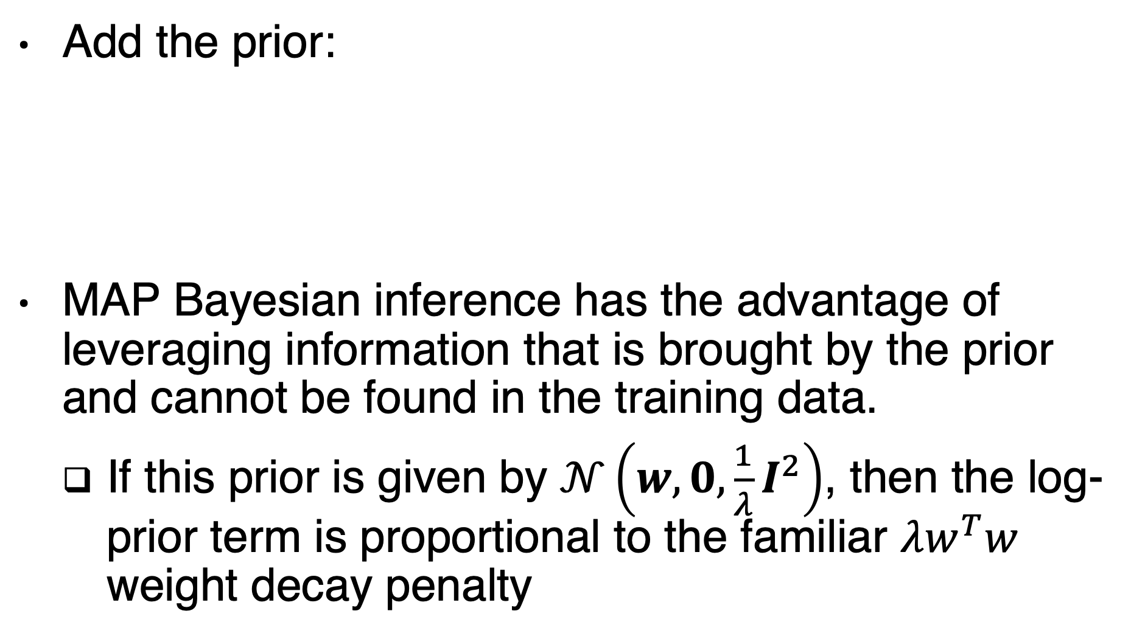
Maximum A Posteriori (MAP) Estimation
Add the prior:
MAP Bayesian inference has the advantage of leveraging information that is brought by the prior and cannot be found in the training data.
If this prior is given by $𝒩\left(w, 0,\frac{1}{λ}I^{2}\right)$, then the log-prior term is proportional to the familiar $λw^{T}w$ weight decay penalty

Slide 50
Supervised learning examples
Logistic regression
Support vector machines
Decision trees

Slide 51
Logistic regression
There is no closed-form solution for the optimal weights.
Instead, we must search for them by maximizing the log-likelihood.
We can do this by minimizing the negative log-likelihood (NLL) using gradient descent.

Slide 52
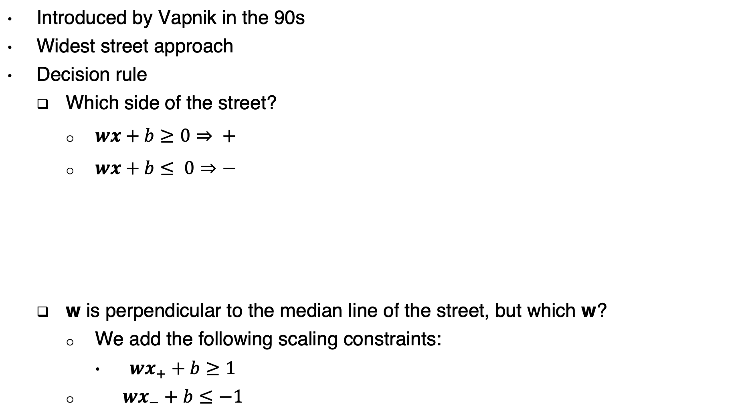
Support vector machines
Introduced by Vapnik in the 90s
Widest street approach
Decision rule
Which side of the street?
$wx+b≥0⇒ +$
$wx+b≤ 0⇒−$
w is perpendicular to the median line of the street, but which w?
We add the following scaling constraints:
$wx_{+}+b≥1$
$wx_{−}+b≤−1$

Slide 53
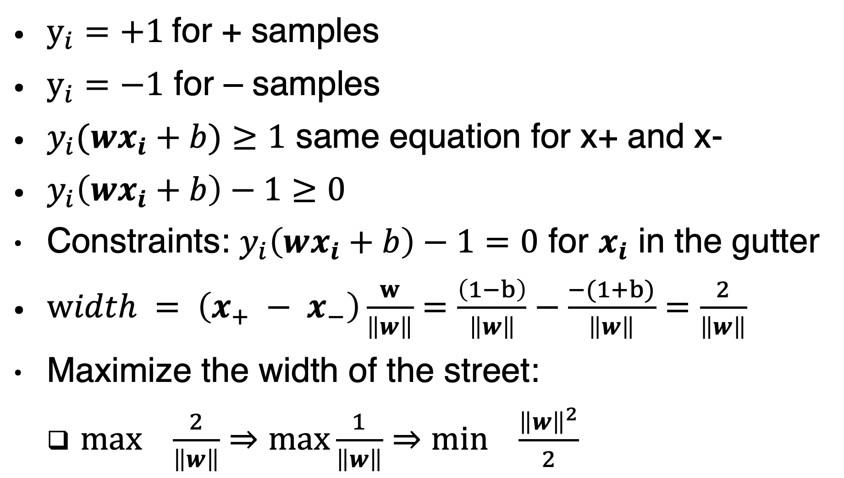
SVM
$y_{i}=+1$for + samples
$y_{i}=−1$ for – samples
$y_{i}(wx_{i}+b)≥1$ same equation for x+ and x-
$y_{i}\left(wx_{i}+b\right)−1≥0$
Constraints: $y_{i}\left(wx_{i}+b\right)−1=0$ for $x_{i}$ in the gutter
$width = \left(x_{+} − x_{−}\right)\frac{w}{\left\|w\right\|}=\frac{\left(1−b\right)}{\left\|w\right\|}−\frac{−(1+b)}{\left\|w\right\|}=\frac{2}{\left\|w\right\|}$
Maximize the width of the street:
$\max_{}{\frac{2}{\left\|w\right\|}}⇒\max_{}{\frac{1}{\left\|w\right\|}⇒\min_{}{\frac{{\left\|w\right\|}^{2}}{2}}}$
Notes:
$\min_{}{\frac{{\left\|w\right\|}^{2}}{2}}$ is an optimization problem with a convex quadratic objective and only linear constraints.
This optimization problem can be solved using commercial quadratic programming (QP) code.

Slide 54
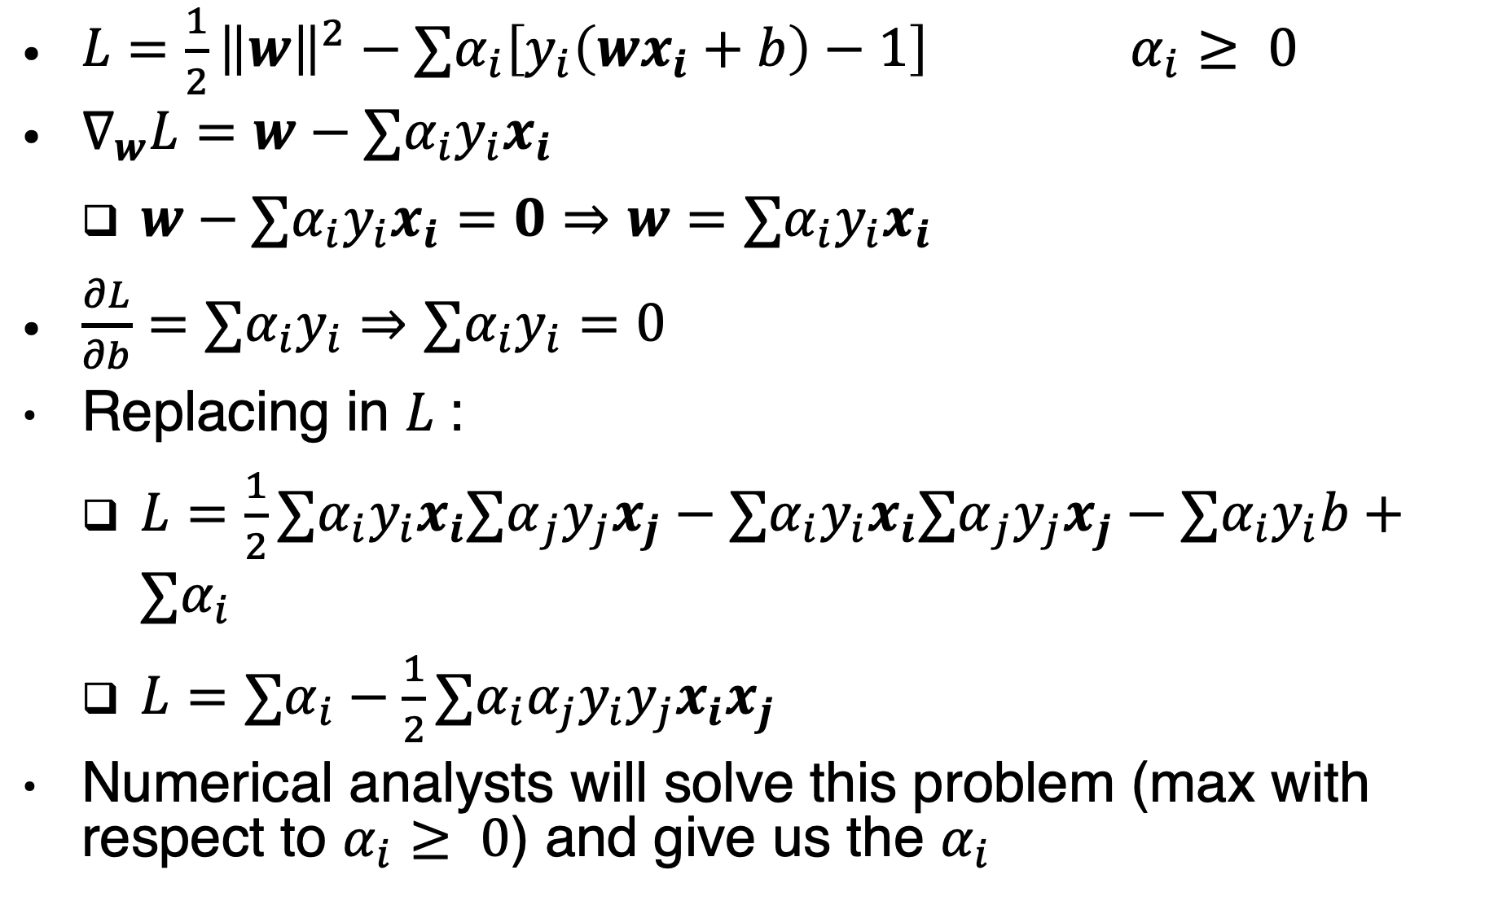
Lagrange multipliers
$L=\frac{1}{2}{\left\|w\right\|}^{2}−∑α_{i}\left[y_{i}\left(wx_{i}+b\right)−1\right]$ $α_{i}≥ 0$
$∇_{w}L=w−{∑α}_{i}y_{i}x_{i}$
$w−{∑α}_{i}y_{i}x_{i}=0⇒w={∑α}_{i}y_{i}x_{i}$
$\frac{∂L}{∂b}=∑α_{i}y_{i}⇒∑α_{i}y_{i}=0$
Replacing in $L$:
$L=\frac{1}{2}{∑α}_{i}y_{i}x_{i}{∑α}_{j}y_{j}x_{j}−∑α_{i}y_{i}x_{i}{∑α}_{j}y_{j}x_{j}−{∑α}_{i}y_{i}b+∑α_{i}$
$L=∑α_{i}−\frac{1}{2}{∑α}_{i}{α_{j}y}_{i}y_{j}x_{i}x_{j}$
Numerical analysts will solve this problem (max with respect to $α_{i}≥ 0$) and give us the $α_{i}$
Notes:
The problem has only inequality constraints : $−α_{i}\left[y_{i}\left(wx_{i}+b\right)−1\right]≤0$

Slide 55
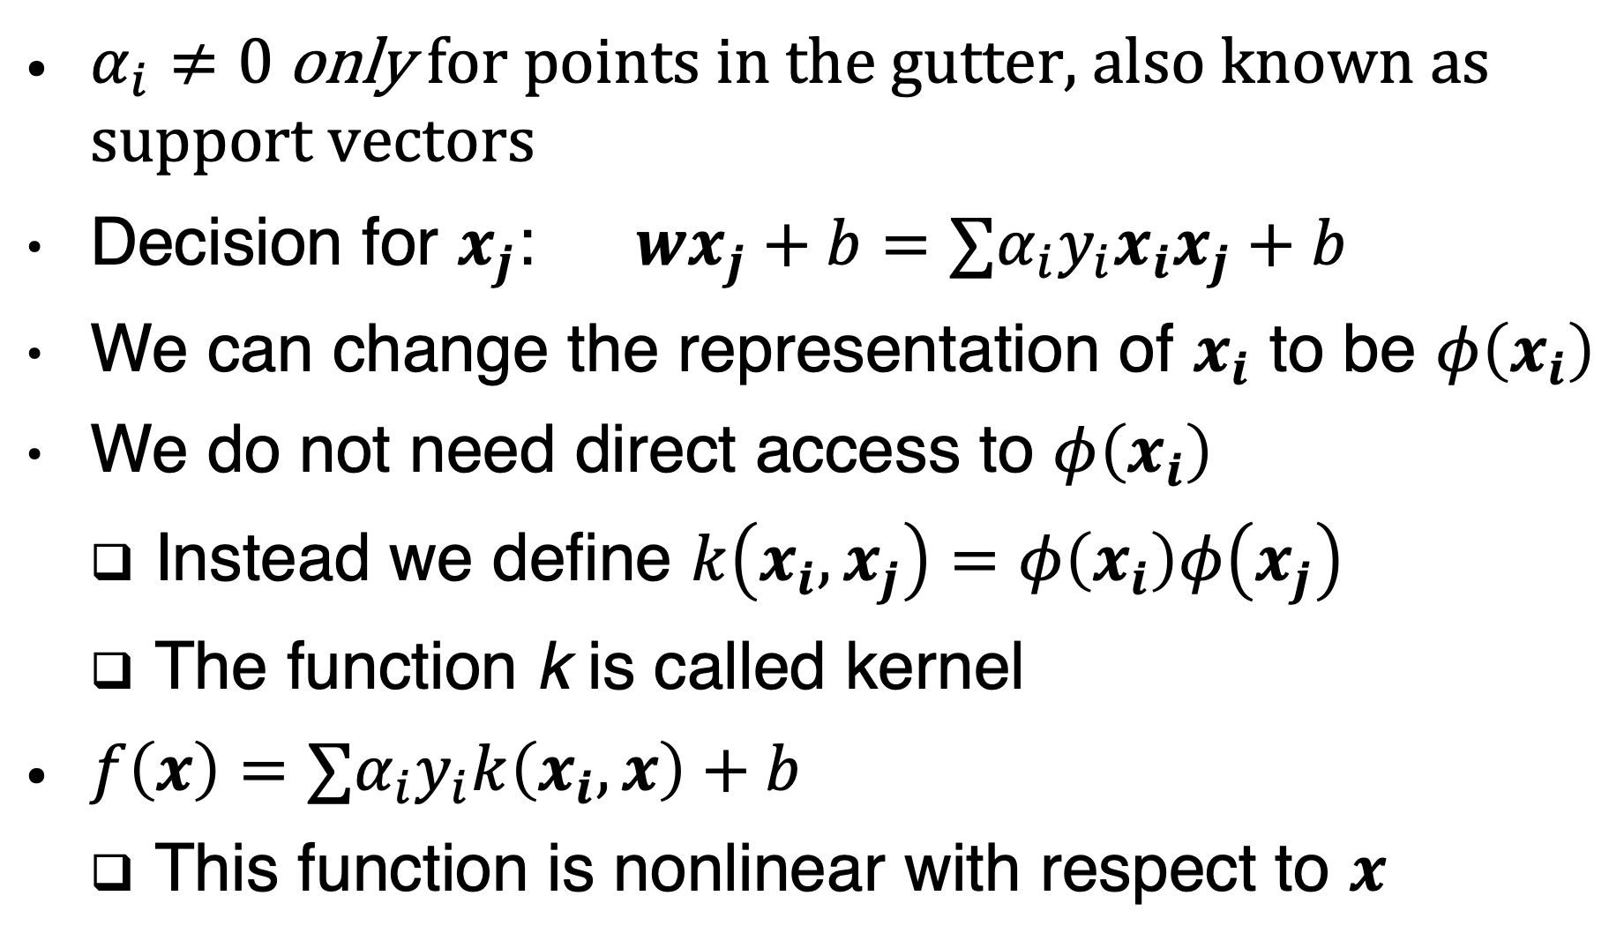
Kernel trick
$α_{i}≠0$ only for points in the gutter, also known as support vectors
Decision for $x_{j}$: $wx_{j}+b={∑α}_{i}y_{i}x_{i}x_{j}+b$
We can change the representation of $x_{i}$ to be $φ\left(x_{i}\right)$
We do not need direct access to $φ\left(x_{i}\right)$
Instead we define $k\left(x_{i},x_{j}\right)=φ\left(x_{i}\right)φ\left(x_{j}\right)$
The function k is called kernel
$f\left(x\right)={∑α}_{i}y_{i}k\left(x_{i},x\right)+b$
This function is nonlinear with respect to $x$

Slide 56
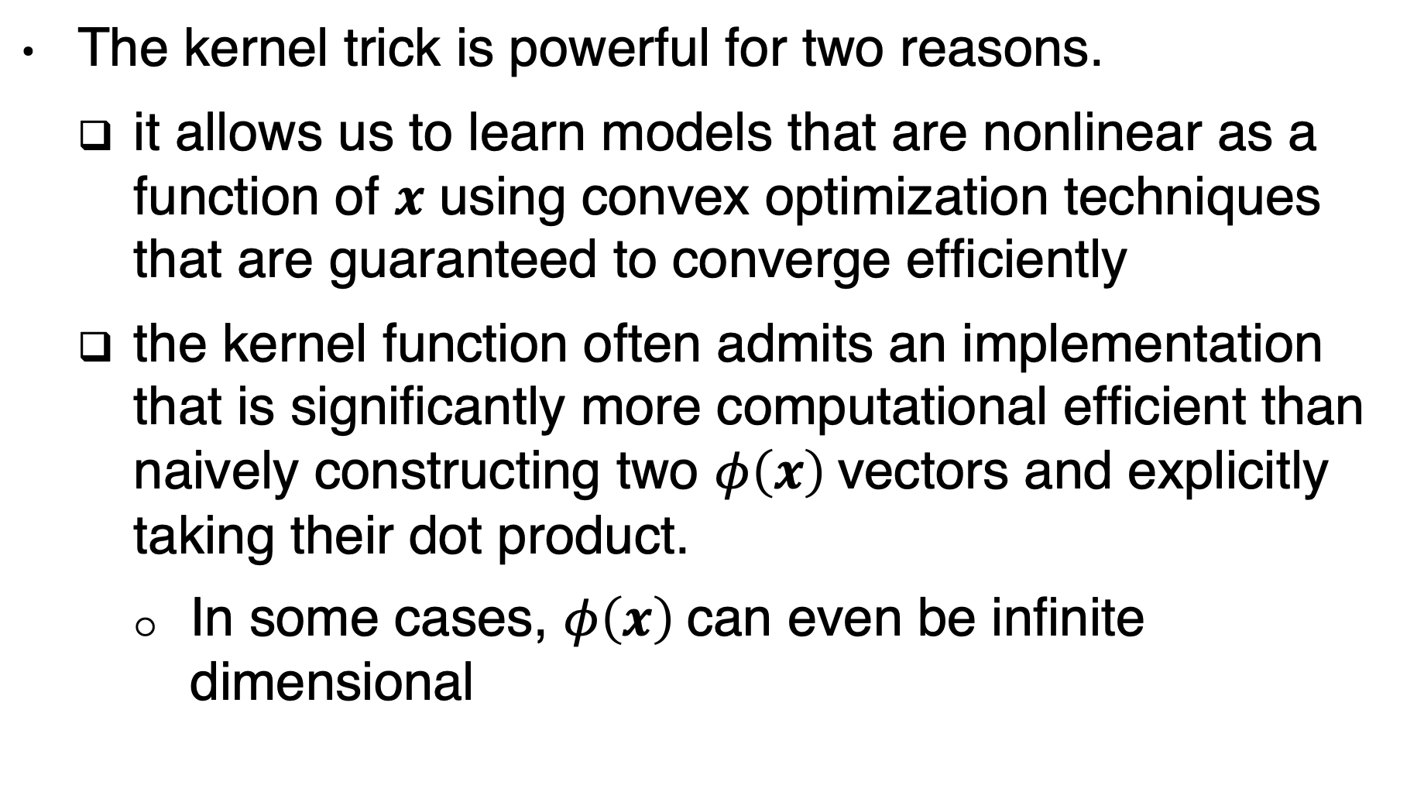
Advantages of the kernel trick
The kernel trick is powerful for two reasons.
it allows us to learn models that are nonlinear as a function of $x$ using convex optimization techniques that are guaranteed to converge efficiently
the kernel function often admits an implementation that is significantly more computational efficient than naively constructing two $φ\left(x\right)$vectors and explicitly taking their dot product.
In some cases, $φ\left(x\right)$can even be infinite dimensional

Slide 57
Gaussian kernel
Gaussian kernel
Aka RBF: Radial Basis Function
We can think of the Gaussian kernel as performing a kind of template matching.
A training example x associated with training label y becomes a template for class y.
When a test point x’ is near x according to Euclidean distance, the Gaussian kernel has a large response, indicating that x’ is very similar to the x template.
The model then puts a large weight on the associated training label y.
Overall, the prediction will combine many such training labels weighted by the similarity of the corresponding training examples.
Notes:
As an example of an infinite-dimensional feature space with a tractable kernel, we
construct a feature mapping φ(x) over the non-negative integers x. Suppose that
this mapping returns a vector containing x ones followed by infinitely many zeros.
We can write a kernel function k(x, x(i)) = min(x, x(i)) that is exactly equivalent
to the corresponding infinite-dimensional dot product.

Slide 58
SVM limitations
high computational cost of training when the dataset is large.
The current deep learning renaissance began when Hinton et al. (2006) demonstrated that a neural network could outperform the RBF kernel SVM on the MNIST benchmark.

Slide 59
Watch (SVM)
https://www.youtube.com/watch?v=_PwhiWxHK8o

Slide 60
K-Nearest Neighbors
There is not even really a training stage or learning process.
We find the k-nearest neighbors to x in the training data X. We then return the average of the corresponding y values in the training set
In the case of classification, we can average over one-hot code vectors
We can then interpret the average over these one-hot codes as giving a probability distribution over classes

Slide 61
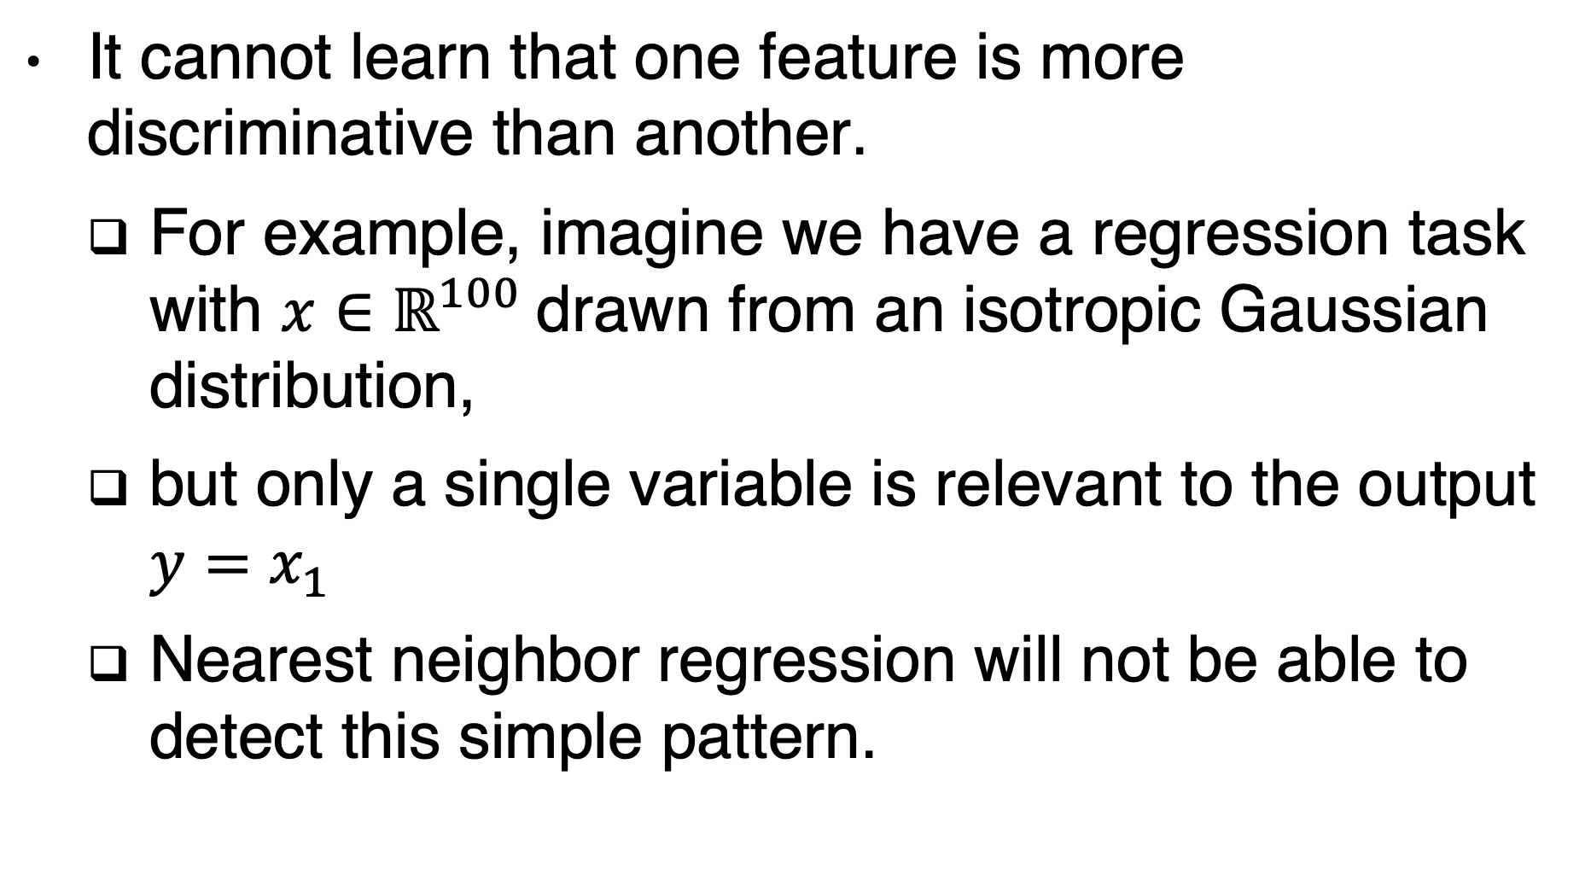
K-NN limitations
It cannot learn that one feature is more discriminative than another.
For example, imagine we have a regression task with ${x∈ℝ}^{100}$drawn from an isotropic Gaussian distribution,
but only a single variable is relevant to the output $y=x_{1}$
Nearest neighbor regression will not be able to detect this simple pattern.

Slide 62
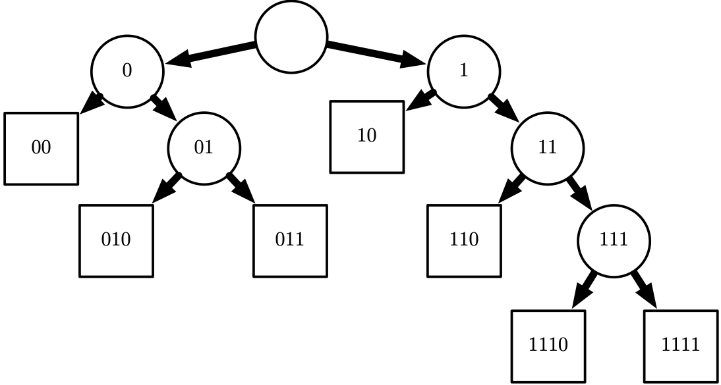
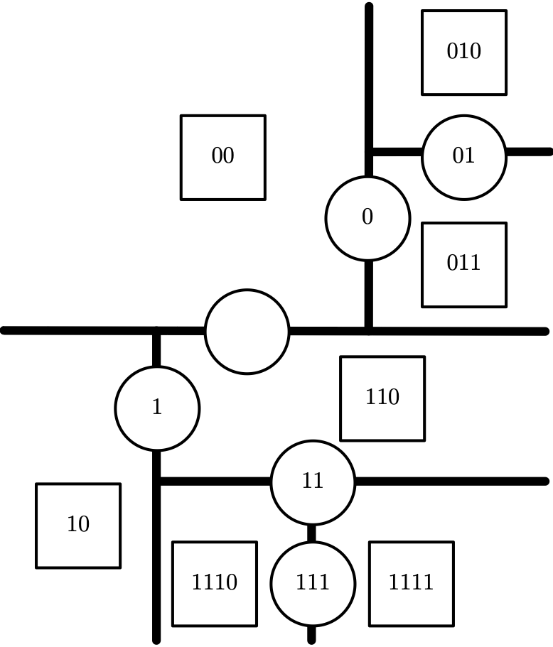
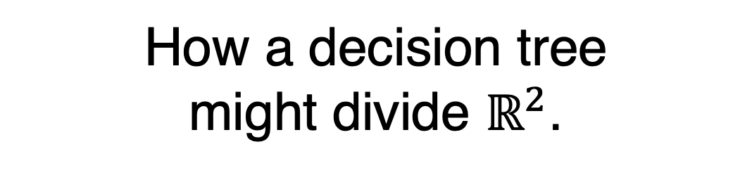
Decision Trees
How a decision tree
might divide $ℝ^{2}$.
Each leaf requires at least one training example to define,
so it is not possible for the decision tree to learn a function that has more local maxima than the number of training examples.
Figure 5.7

Slide 63
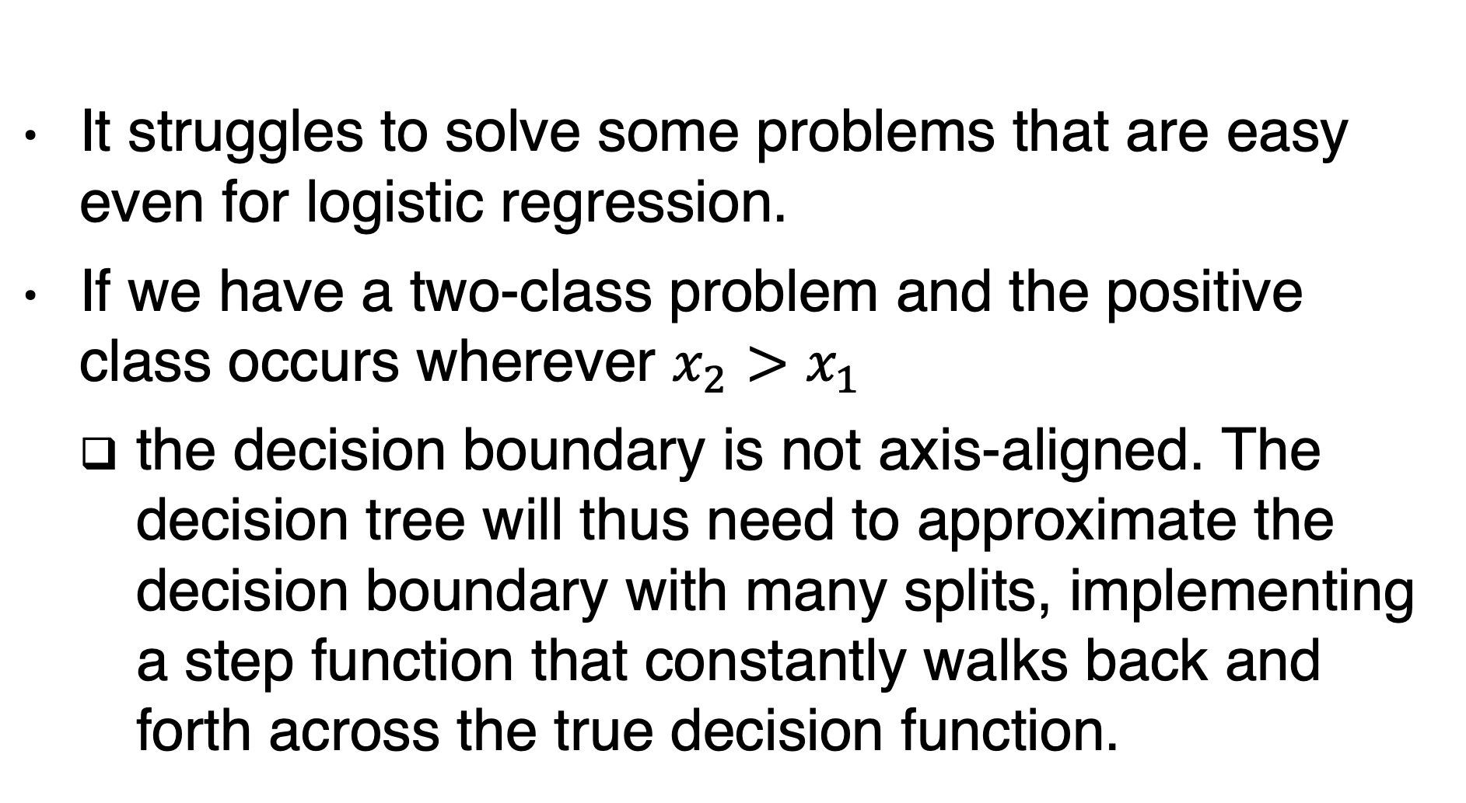
Decision trees limitations
It struggles to solve some problems that are easy even for logistic regression.
If we have a two-class problem and the positive class occurs wherever $x_{2}>x_{1}$
the decision boundary is not axis-aligned. The decision tree will thus need to approximate the decision boundary with many splits, implementing a step function that constantly walks back and forth across the true decision function.

Slide 64
Unsupervided learning
Density estimation
Learning to draw samples from a distribution
Learning to denoise data from some distribution
Clustering the data into groups of related examples
Simpler representation:
Lower-dimensional representation
Sparse representation
Independent representation

Slide 65
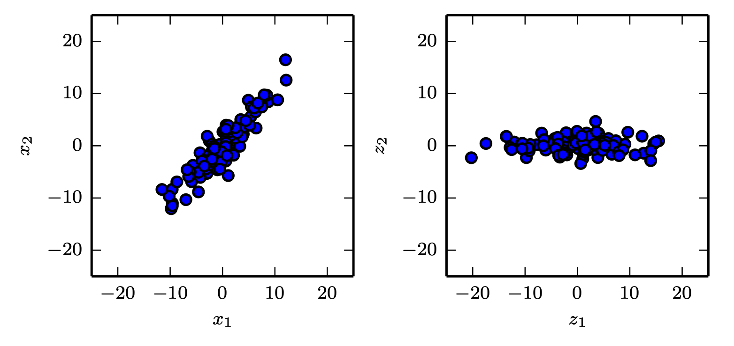
Principal Components Analysis
lower dimensionality
no linear correlation

Slide 66
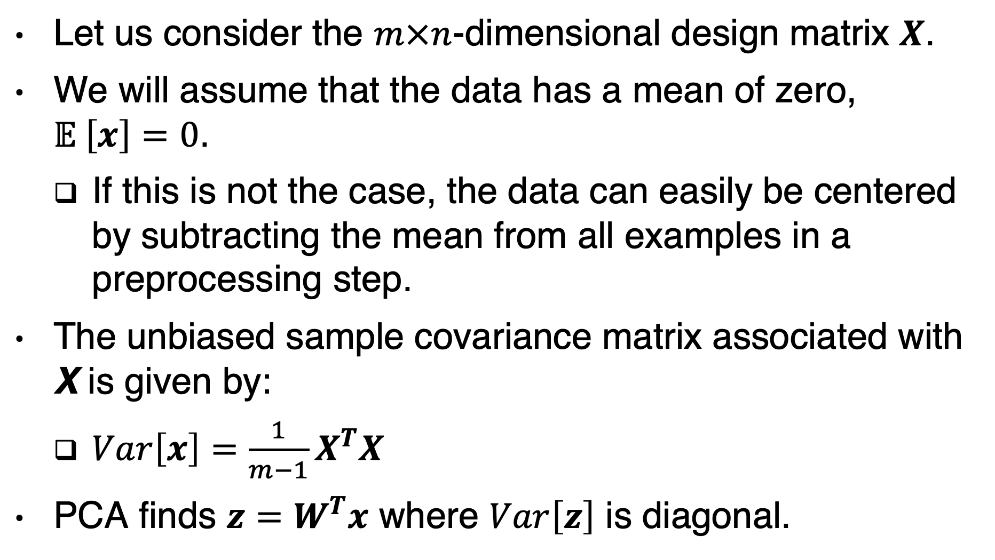
No linear correlation
Let us consider the $m×n$-dimensional design matrix $X$.
We will assume that the data has a mean of zero, $𝔼 \left[x\right]=0$.
If this is not the case, the data can easily be centered by subtracting the mean from all examples in a preprocessing step.
The unbiased sample covariance matrix associated with X is given by:
$Var\left[x\right]=\frac{1}{m−1}X^{T}X$
PCA finds $z=W^{T}x$ where $Var\left[z\right]$ is diagonal.

Slide 67
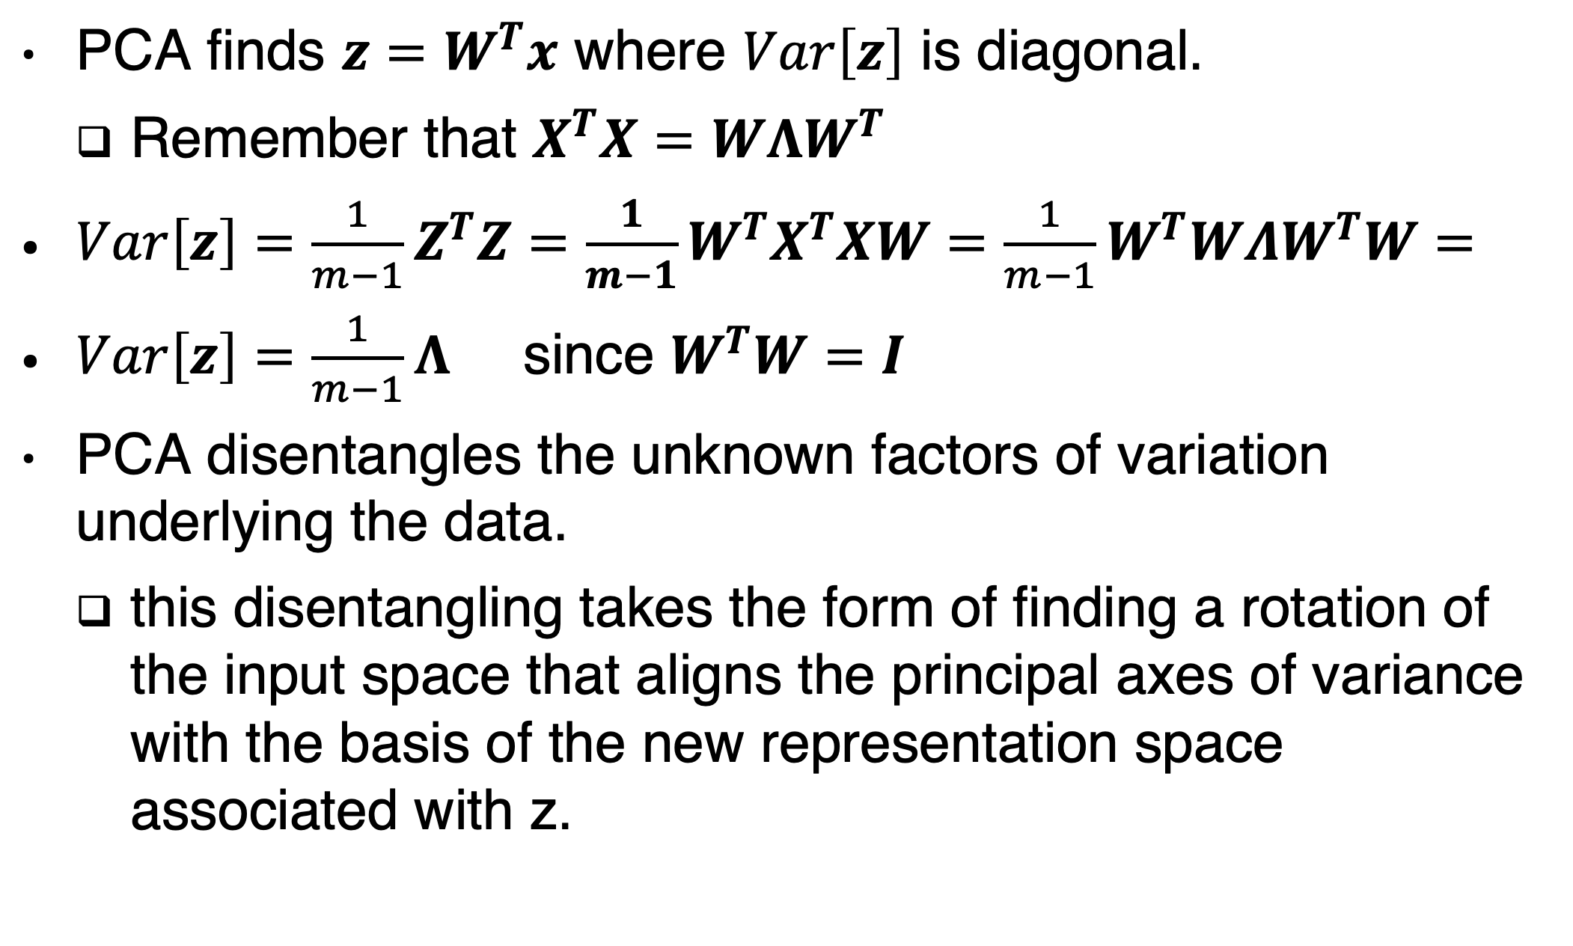
Decorrelation
PCA finds $z=W^{T}x$ where $Var\left[z\right]$ is diagonal.
Remember that $X^{T}X=WΛW^{T}$
$Var\left[z\right]=\frac{1}{m−1}Z^{T}Z=\frac{1}{m−1}W^{T}X^{T}XW=\frac{1}{m−1}W^{T}WΛW^{T}W=$
$Var\left[z\right]=\frac{1}{m−1}Λ$ since $W^{T}W=I$
PCA disentangles the unknown factors of variation underlying the data.
this disentangling takes the form of finding a rotation of the input space that aligns the principal axes of variance with the basis of the new representation space associated with z.

Slide 68
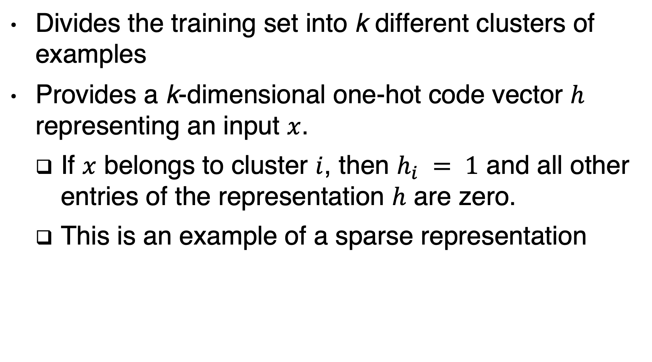
k-means clustering
Divides the training set into k different clusters of examples
Provides a k-dimensional one-hot code vector $h$ representing an input $x$.
If $x$ belongs to cluster $i$, then $h_{i} = 1$ and all other entries of the representation $h$ are zero.
This is an example of a sparse representation

Slide 69
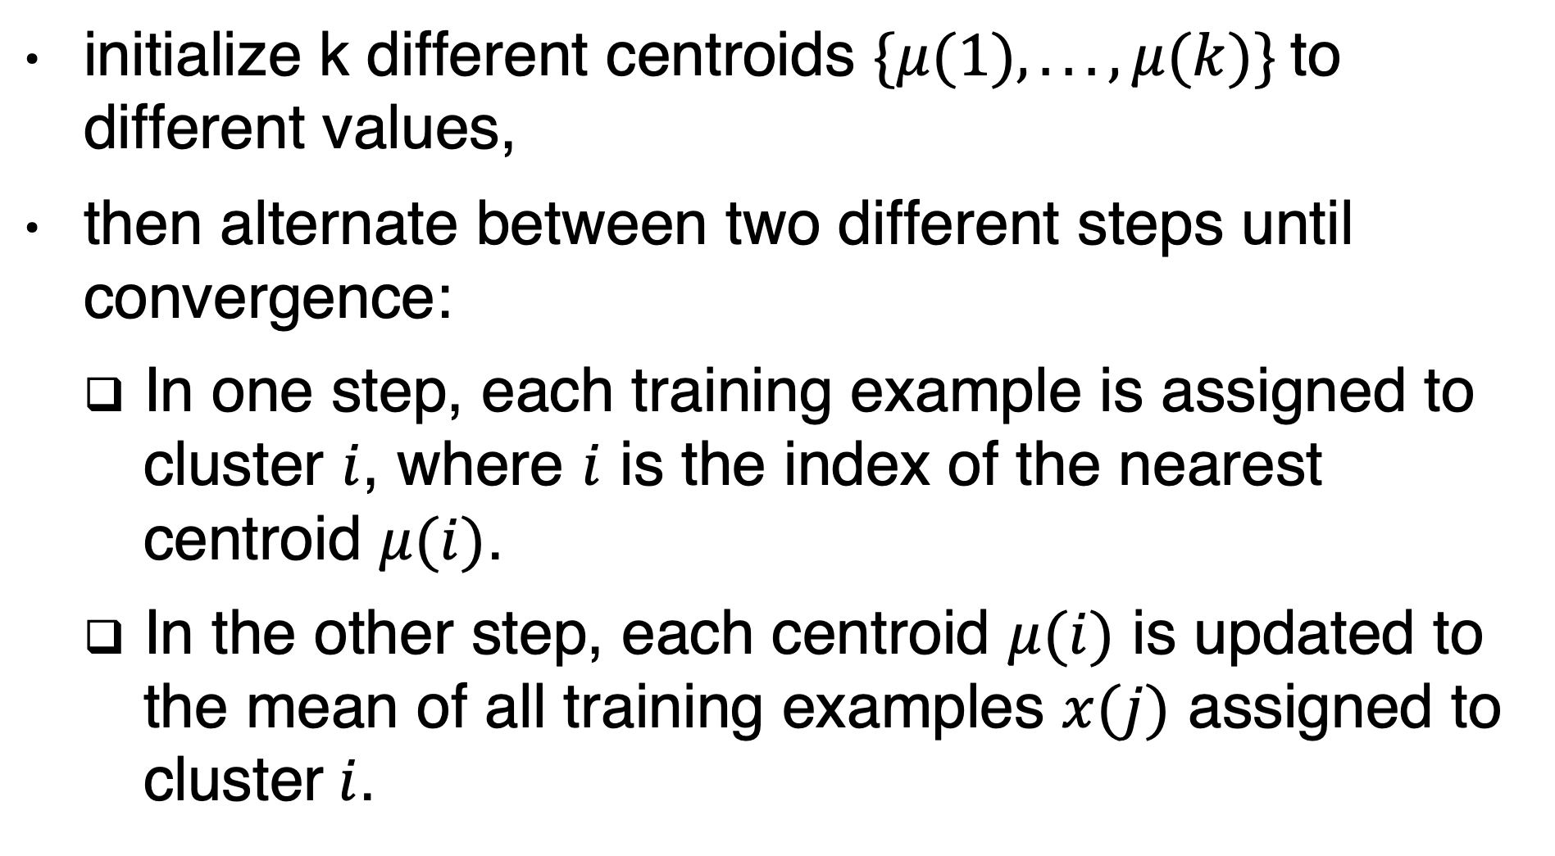
k-means algorithm
initialize k different centroids $\{μ(1), . . . ,μ(k)\}$to different values,
then alternate between two different steps until convergence:
In one step, each training example is assigned to cluster $i$, where $i$ is the index of the nearest centroid $μ(i)$.
In the other step, each centroid $μ(i)$ is updated to the mean of all training examples $x(j)$ assigned to cluster$i$.

Slide 70
How to evaluate clustering?
Suppose we have images of
Red trucks, gray trucks
Red cars, gray cars
One clustering algorithm may find a cluster of cars and a cluster of trucks
Another learning algorithm may find a cluster of red vehicules and a cluster of gray vehicules
A third algorithm may find 4 clusters …
Red cars similarity to gray trucks is same as their similarity to gray cars!
A distributed representation may have two attributes for each vehicule

Slide 71
Building a machine learning algorithm
Simple recipe
A dataset
A cost function (e.g. MSE, negative log-likelihood)
A model (e.g. linear, non-linear)
An optimization procedure (closed form, gradient descent, stochastic gradient descent …)

Slide 72
Exercise
Link equations and definitions

Slide 73
Stochastic gradient descent
Computing the gradient is O(m)
Sample a mini-batch

Slide 74
Challenges motivating deep learning
Simple machine learning algorithms work very well on a wide variety of important problems.
However, they have not succeeded in solving the central problems in AI, such as recognizing speech or recognizing objects.
Generalizing to new examples becomes exponentially more difficult when working with high-dimensional data,
Such data also often impose high computational costs.

Slide 75
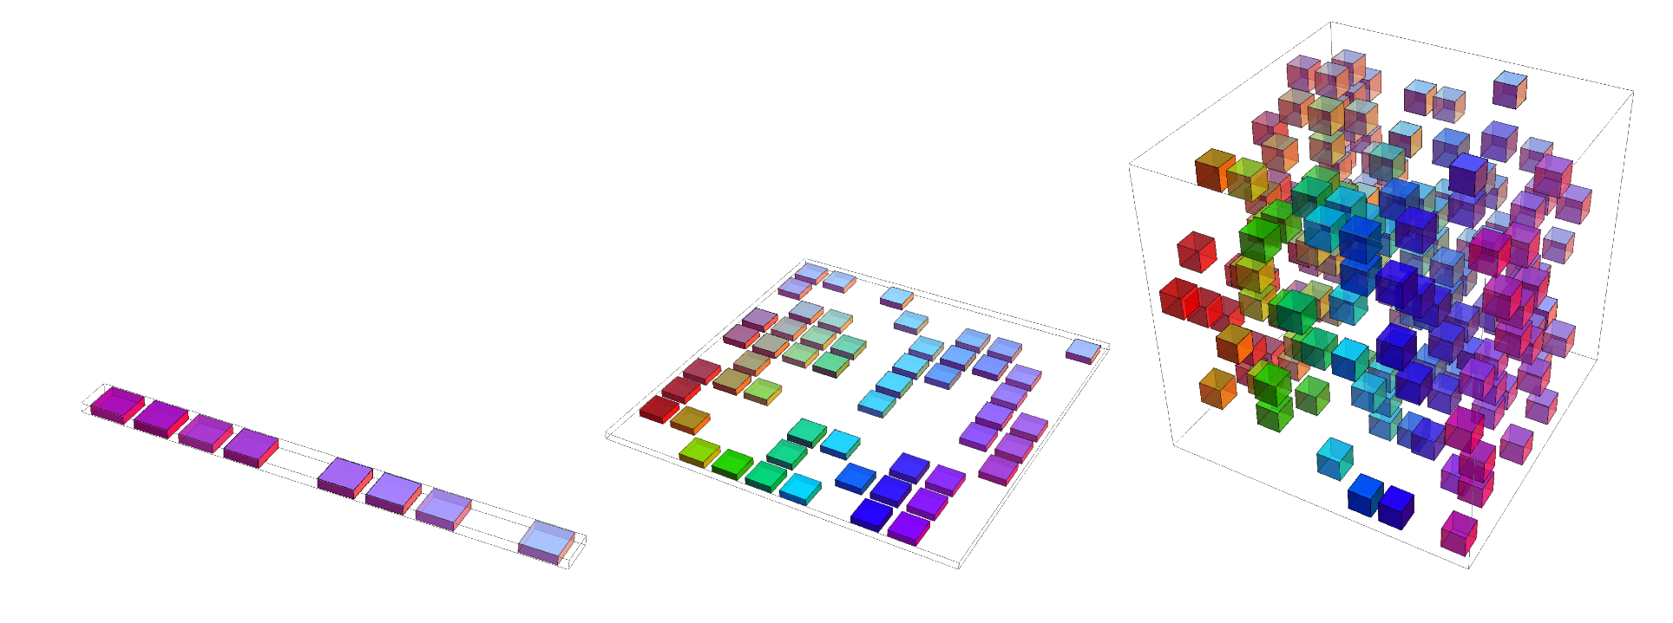
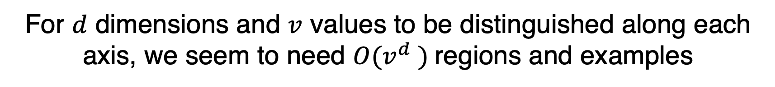
Curse of Dimensionality
Many machine learning problems become exceedingly difficult when the number of dimensions in the data is high.
one variable, 10
regions of interest.
two variables, 10
regions of interest each.
three variables, 10
regions of interest each.
For $d$ dimensions and $v$ values to be distinguished along each
axis, we seem to need $O(v^{d} )$regions and examples
Notes:
For example, if estimating the probability
density at some point x, we can just return the number of training examples in
the same unit volume cell as x, divided by the total number of training examples.

Slide 76


Smoothness prior (aka local consistency)
the function we learn should not change very much within a small region.
KNN
RBF kernel
Decision trees
to distinguish $O(k)$ regions in input space, all of these methods require $O(k)$ examples
Voronoi
diagram

Slide 77
Smoothness prior is not enough!
Is there a way to represent a complex function that has many more regions to be distinguished than the number of training examples?
A checkerboard contains many variations but there is a simple structure to them.
The answer is Yes:
If we introduce some dependencies between the regions
via additional assumptions about the underlying data generating distribution

Slide 78
Deep learning solution
Deep learning assumes that the data was generated by the composition of factors or features, potentially at multiple levels in a hierarchy
These apparently mild assumptions allow an exponential gain in the relationship between the number of examples and the number of regions that can be distinguished.
Deep and distributed representations counter the curse of dimensionality.

Slide 79
Manifold
A manifold is a connected set of points
that can be approximated well by considering only a small number of degrees of freedom, or dimensions, embedded in a higher-dimensional space.
A manifold is a set of points, associated with a neighborhood around each point.
Transformations can be applied to move on the manifold from one position to a neighboring one.
From any given point, the manifold locally appears to be an Euclidean space.
In everyday life, we experience the surface of the world as a 2-D plane, but it is in fact a spherical manifold in 3-D space.

Slide 80

Manifold
One-dimensional manifold embedded in two dimensional
space.

Slide 81
Manifold
we allow the dimensionality of the manifold to vary from one point to another.
This often happens when a manifold intersects itself.
For example, a figure eight is a manifold that has a single dimension in most places but two dimensions at the intersection at the center.

Slide 82

Manifold learning
Manifold learning algorithms assumes that most of $ℝ^{n}$ consists of invalid inputs,
interesting inputs occur only along a collection of manifolds
Interesting variations in the output of the learned function occurring only along directions that lie on the manifold,
or with interesting variations happening only when we move from one manifold to another.
the key assumption remains that probability mass is
highly concentrated.

Slide 83

Arguments supporting the manifold hypothesis
the probability distribution over images, text strings, and sounds that occur in real life is highly concentrated.
Uniformly Sampled Images

Slide 84

Arguments supporting the manifold hypothesis
Examples we encounter are connected to each other by applying transformations to traverse the manifold.
QMUL Dataset

Slide 85
Conclusion
The manifold assumption is at least approximately correct.
This concludes part I of the course
You are now prepared to embark upon your study of deep learning.
Congratulations

